Slide 1
WELCOME Art7D 2020! Lecture Attendance: Please get app from arkaive.com Enrollment Code: GNQD

Slide 2
Lecture Interaction
on your mobile go to
www.sli.do
Code for the lecture today: L2H

Slide 3
Computer and Internet History

Slide 4
The COMPUTER

Slide 5
What is a Computer? A general purpose machine, commonly consisting of digital circuitry, that accepts (inputs), stores, manipulates, and generates (outputs) data as numbers, text, graphics, voice, video files, or electrical signals, in accordance with instructions called a program. http://www.businessdictionary.com

Slide 6
Why were computers invented?
Need:
To solve human conflicts (or transcend the conflicts by connecting with God!).
Solution:
Distill complex information down to simple units such as ones and zeroes (Binary Numbers)
Create a way to calculate on the ones and zeroes (Boolean Logic)
And a way to store and transmit the information (Punch cards, Electricity, magnetism…)

Slide 7
Zairja. An Arab mechanical device for generating ideas
mentioned in texts from the 1300 as an ancient device.

Slide 8
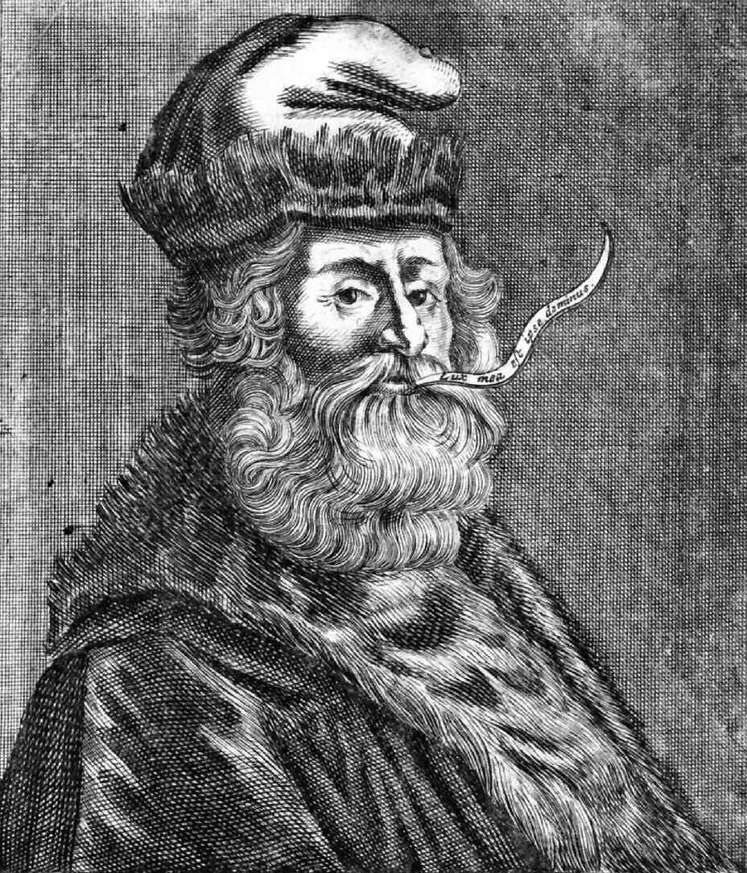
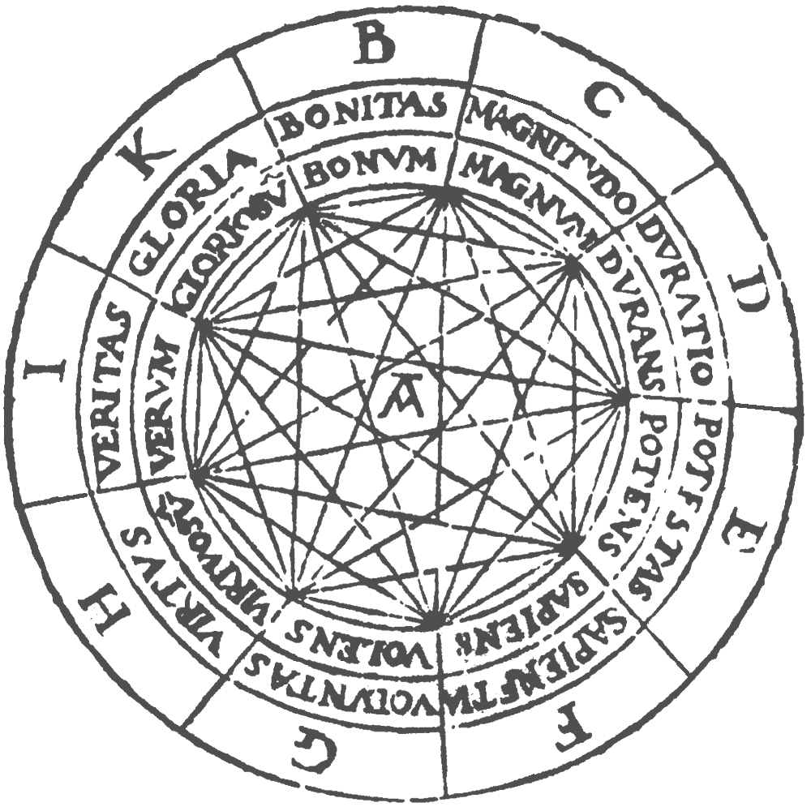
Raymond Llull (1232 - 1315)
Ars Magna ‘The Great Art’
Wheels on top of wheels containing letters and words symbolizing divine concepts. When moving the wheels, combinations of these concepts supposedly generate proofs of universal religious truths.

Slide 9
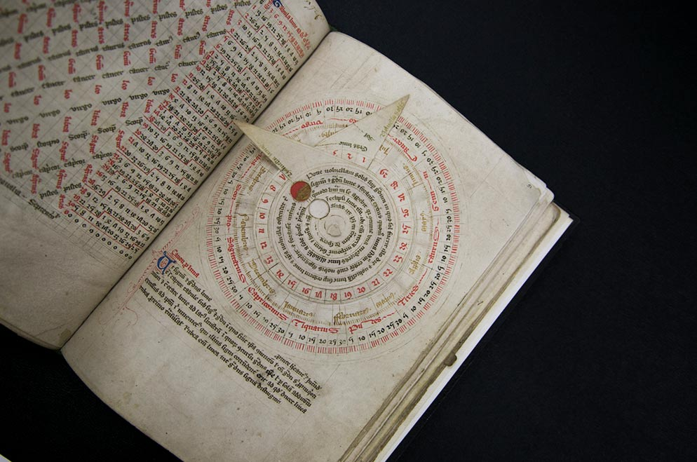
Astronomical Vovelle, from Astronomical and Medical Miscellany, English, approx. 1386.

Slide 10
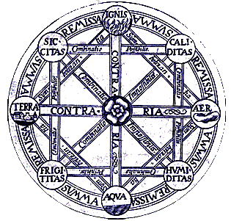
Gottfried Wilhelm Leibniz (1646-1716)
Characteristica Universalis/Calculus Ratiocinator
CU was a language that would have numbers representing all primary human emotions and CR was a ‘machine’ that would be able to calculate on those numbers.
Human disagreements, religious, legal, political, could this be solved by calculation rather than violence.
"If controversies were to arise," said Leibniz, "there would be no more need of disputation between two philosophers than between two accountants. For it would suffice to take their pencils in their hands, and say to each other: Let us calculate."

Slide 11
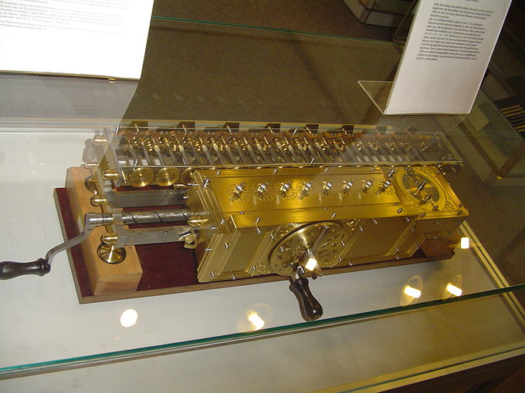
Stepped Reckoner 1672-1694, by Gottfried Wilhelm Leibniz. The first calculator that could perform all four arithmetic operations: addition, subtraction, multiplication and division.

Slide 12
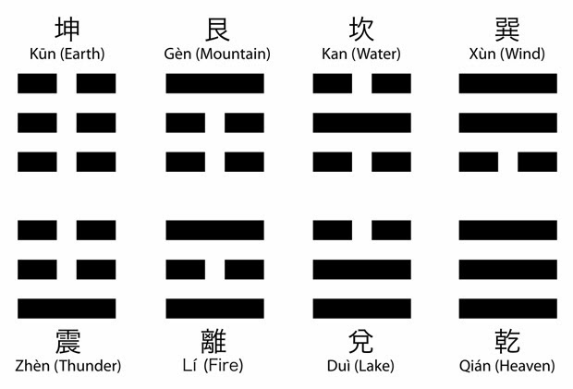
The Binary Numeral System (1679)
Leibniz imagined a calculating machine in which binary numbers were represented by marbles falling into holes (1) or not (0).
(Maybe something like this)
The binary system is a digital system. i.e. it uses discrete values to represent data as opposed to a analog systems where information, sound etc. is represented as a continuous range of values.
Other examples of digital systems are smoke signals, morse code and DNA.
Leibniz saw similarities between the binary system and the Chinese divinatory system “I Ching.”

Slide 13
The Binary Number System
Decimal Binary
1 1
2 10
3 11
4 100
Representing text in the computer:
Char. Dec. Binary
A 65 1000001
B 66 1000010
C 67 1000011
D 68 1000100

Slide 14
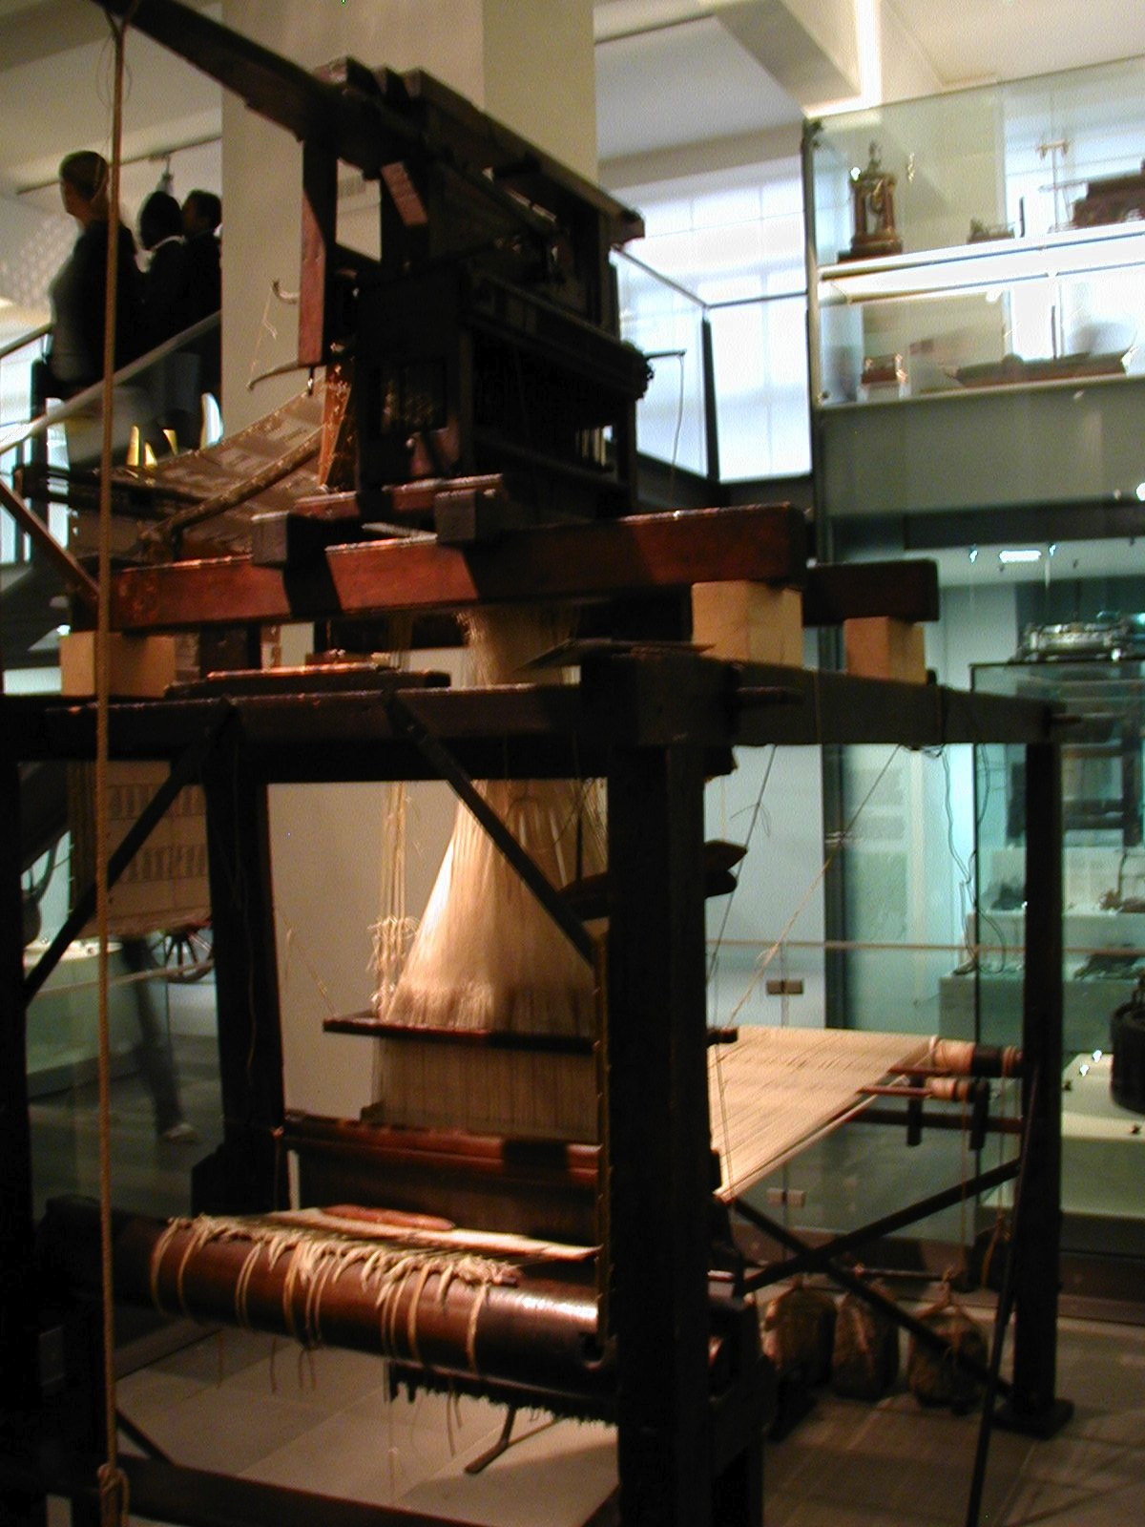
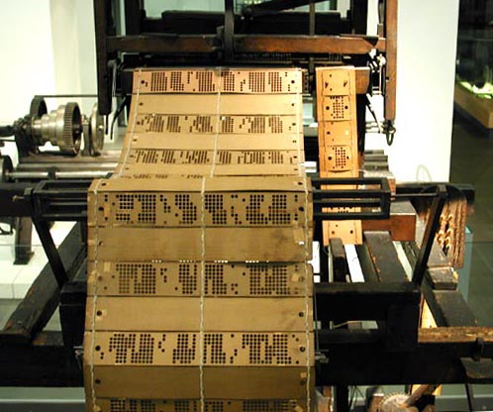
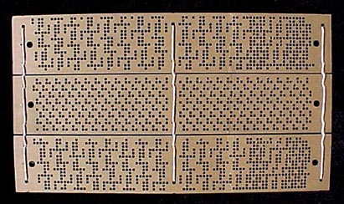
The Jacquard Loom (1801)

Slide 15
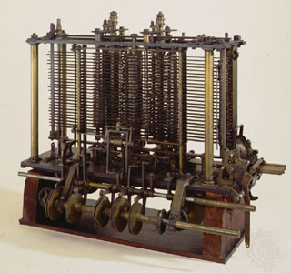
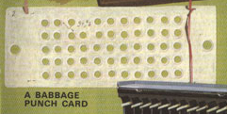
Charles Babbage (1792 -1871) British professor of mathematics
The Analytical Engine (1837 )
A portion of Charles Babbage's Analytical Engine. Only partially built at the time of Babbage's death in 1871, this portion contains the “mill” (functionally analogous to a modern computer's central processing unit) and a printing mechanism. (It was completed 1910.)
Punch card used to input information/instructions into the Analytical Engine

Slide 16
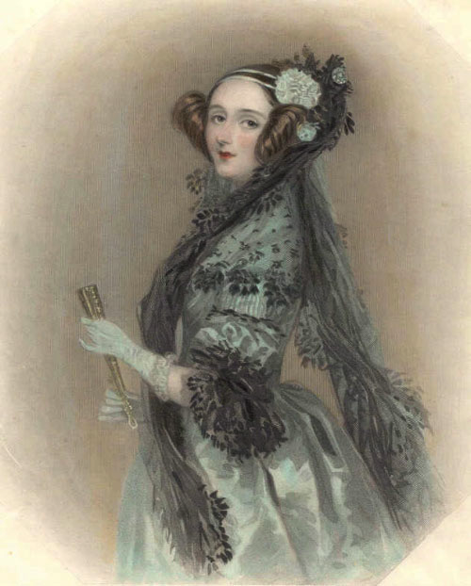
Ada Lovelace (1815-1852), “The First Computer Programmer” English mathematician and writer
Published Observations on Mr. Babbage's Analytical Engine in 1843. This paper explained that the machine used Operation Cards to perform arithmetic on numerical data and respond to symbols representing data. She emphasized the ability to program the machine. It is for this emphasis and development that she is considered the inventor of computer programming.

Slide 17
George Boole (1815-1864) English mathematician, philosopher and logician
“Boolean algebra” provided a basic logic for operations on the binary numbers 0 and 1.
Boole introduced three operators:
AND, OR, NOT.

Slide 18
Claude Shannon (1916-2001) American mathematician, electrical engineer, and cryptographer
In A Symbolic Analysis of Relay and Switching Circuits (1938) Shannon describes how binary statement (1/0 or true/false) could be represented by an electronic circuit being either on or off. This was a very important step towards the digital computer.
DVDs use microscopic dark spots on the surface of the disk to indicate "off," while the ordinary shiny surface is considered "on." Hard disks use magnetism, while computer memory uses electric charges stored in tiny capacitors to indicate "on" or "off."

Slide 19
Alan M Turing (1912-1954) British Mathematician and Cryptographer
Turing Machine (1936): A basic abstract symbol-manipulating mathematical model which can be adapted to simulate the logic of any computer.

Slide 20
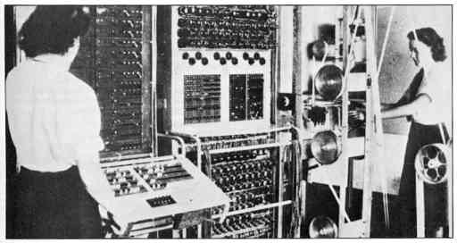
The Colossus Decoder “The world's first programmable, digital, electronic, computing device.” Bletchley Park, England. Cracked the German ‘fish’ code in 1943

Slide 21
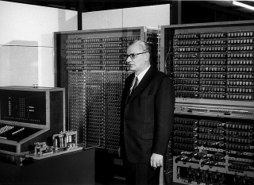
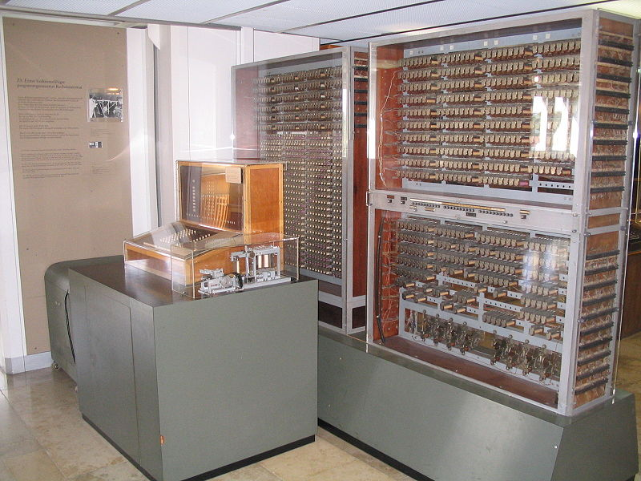
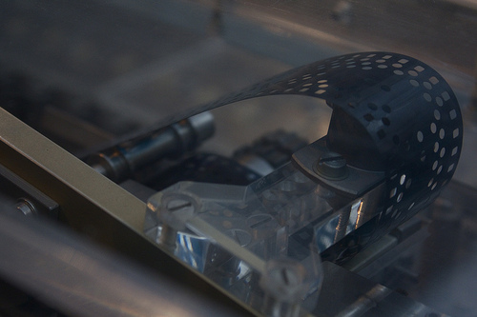
Z3, ”The first automatic, program-controlled, fully functional, general purpose digital computer” by Konrad Zuse 1941, Germany

Slide 22
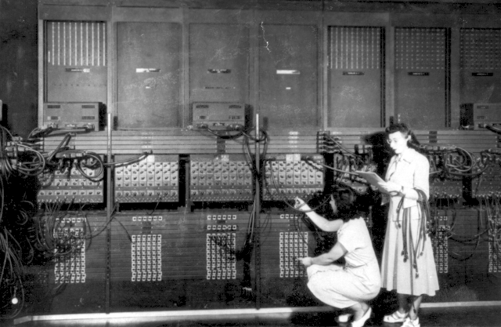
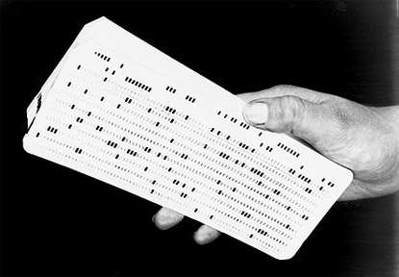
ENIAC (Electronic Numerical Integrator and Computer) 1946 “The first general purpose computer”. 8 feet by 3 feet by 100 feet. University of Pennsylvania

Slide 23
The ENIAC Programmers
Kathleen McNulty, Mauchly Antonelli, Jean Jennings Bartik, Frances Synder Holber, Marlyn Wescoff Meltzer, Frances Bilas Spence and Ruth Lichterman Teitelbaum
Part 1 (Youtube)
Part 2 (Youtube)

Slide 24
“The Stats On Women In Tech Are Actually Getting Worse”, Emily Peck, Huffington Post Dec. 6 2017

Slide 25
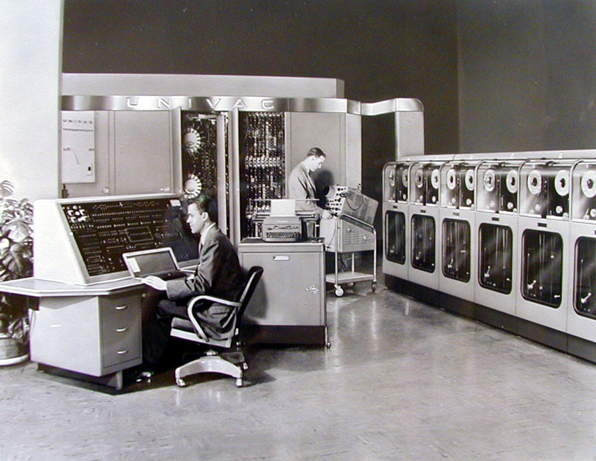
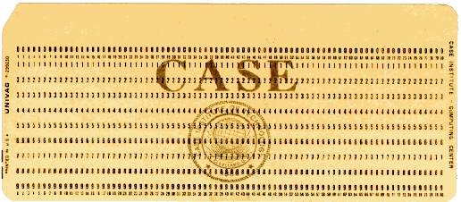
UNIVAC (Universal Automatic Computer) 1951 The first commercially available digital computer, 25 feet by 50 feet

Slide 26
Grace Hopper 1906-1992
Compilers
COBOL

Slide 27
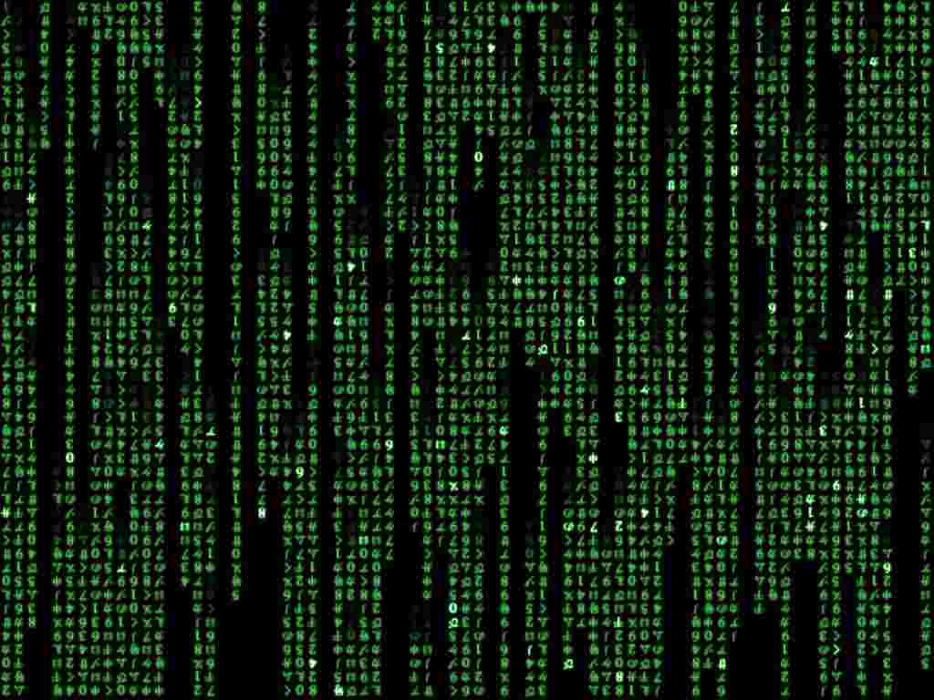
Computer layers
Apps and Software: Photoshop, Microsoft Word, Firefox, Snapchat
Code: Formatting Languages – HTML, CSS
Code: Programming Languages – JavaScript, Processing
Code: Programming Languages – C, C++, Cobol
Code: Assembly Language
Code: Machine Language
Electrical Circuits with On/Off Switches (Ones and Zeroes)

Slide 28
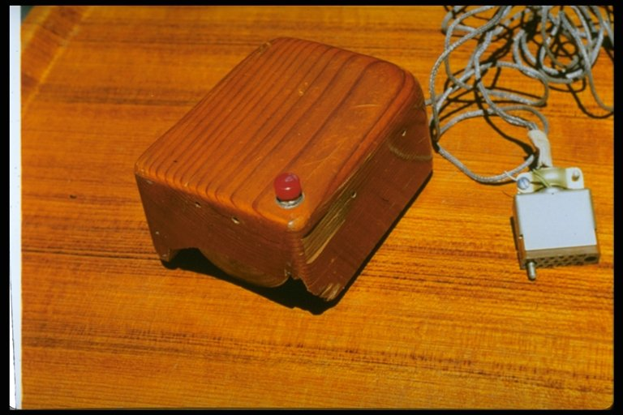
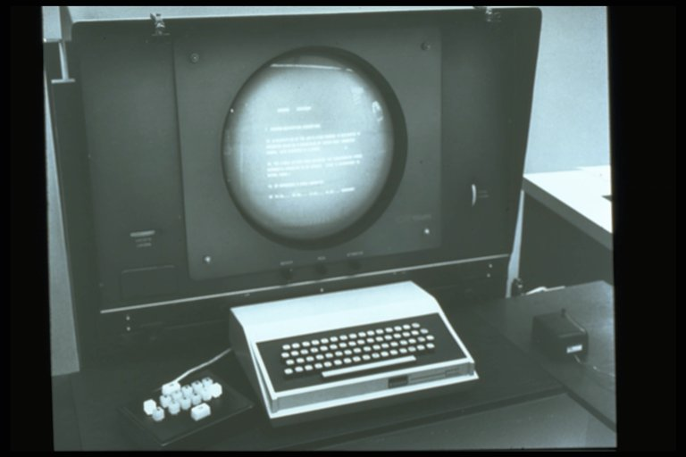
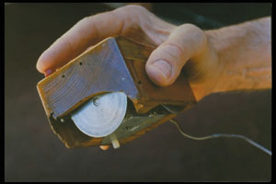
Douglas Engelbart (1925-2013), Stanford Research Institute
The first mouse 1964
Early workstation with keyboard and mouse 1966

Slide 29
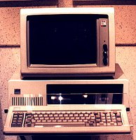
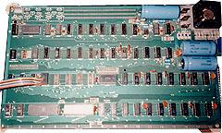
The Personal Computer
Apple 1 1976
Sold without case, keyboard, and monitor
The first highly popular PC by IBM 1981
(Command Line Interface)

Slide 30
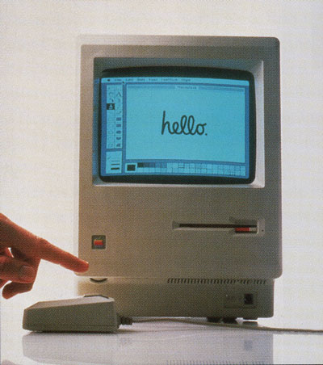
The Personal Computer
Macintosh 128K by Apple 1984. The first personal computer with a Graphical User Interface (developed simultaneously by Xerox PARC and Apple)

Slide 31
Apple’s commercial for their new GUI computer 1984

Slide 32
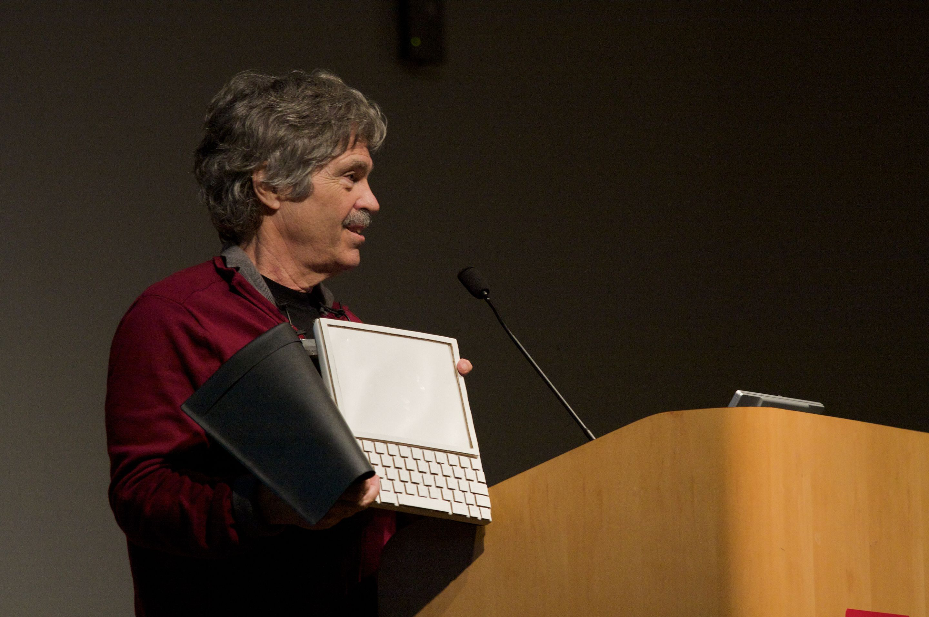
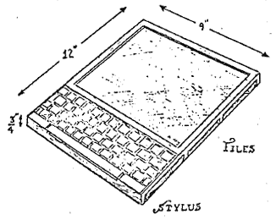
The Laptop
Alan Kay’s Dynabook (1972)

Slide 33
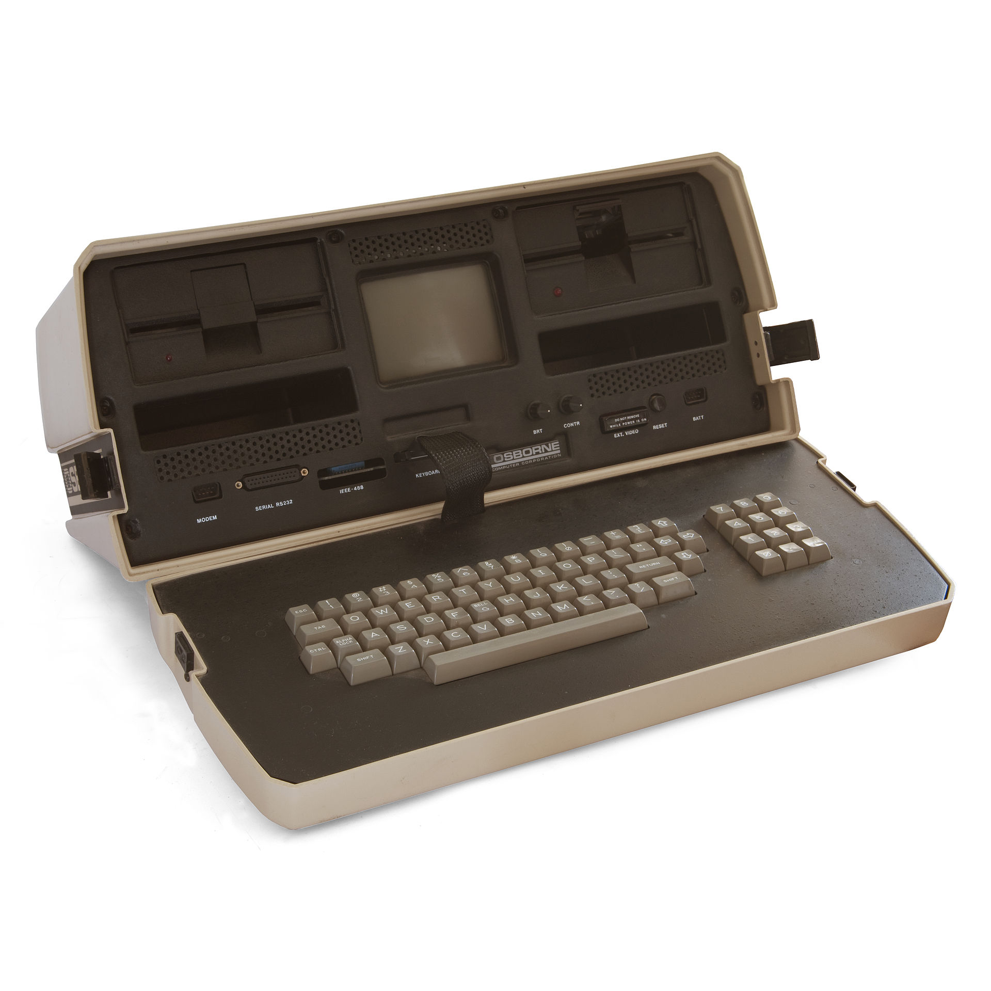
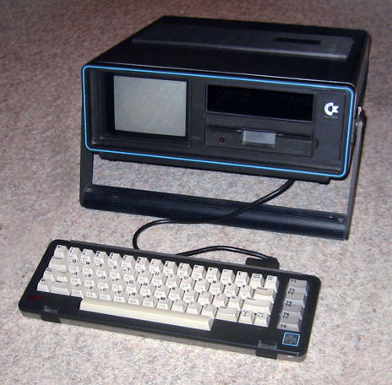
The Laptop
Osborn 1 (1981)
Commodore SX-64 (1983)

Slide 34
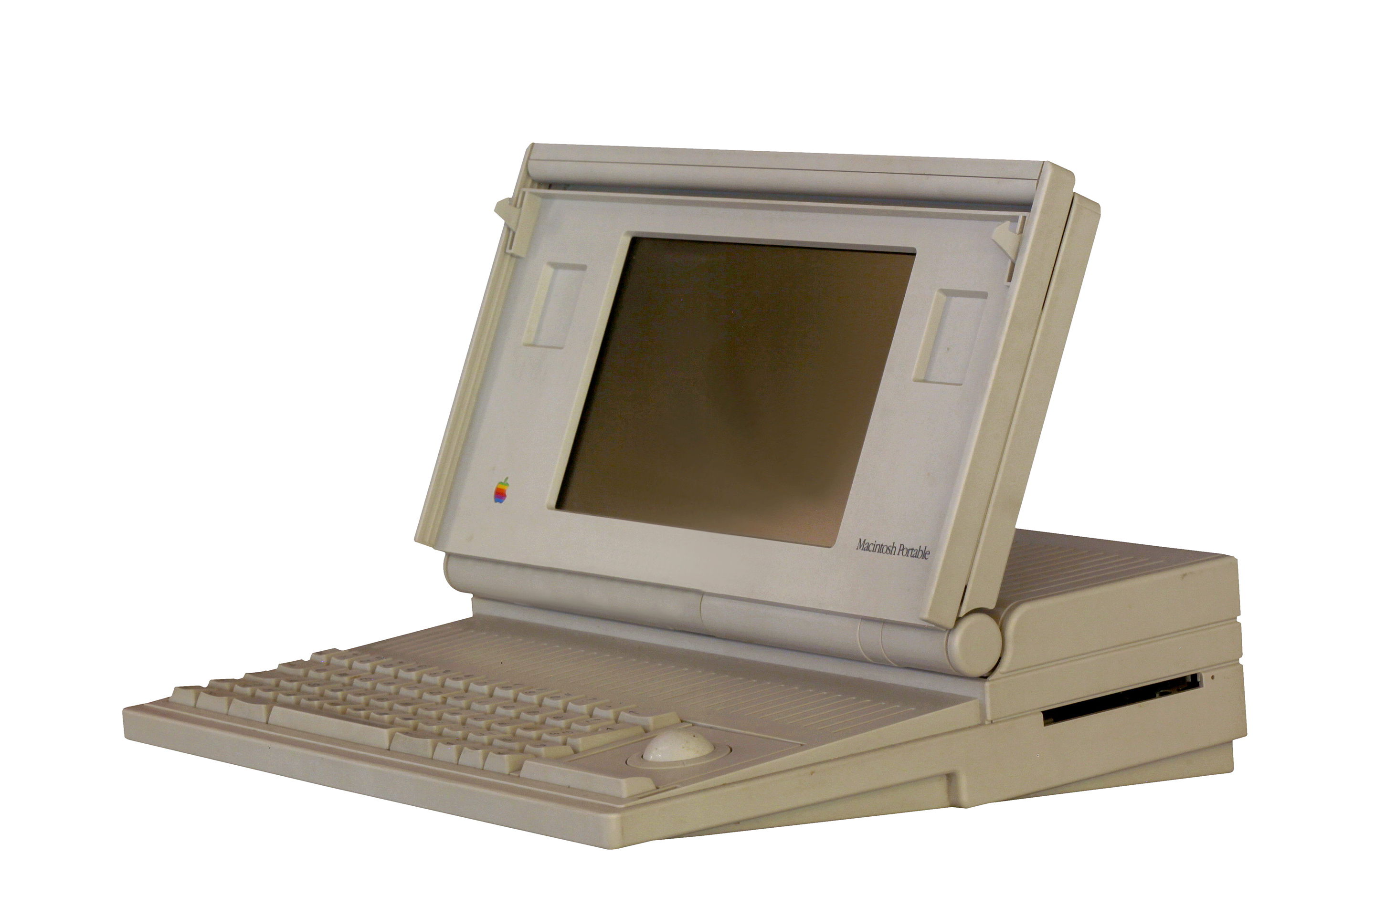
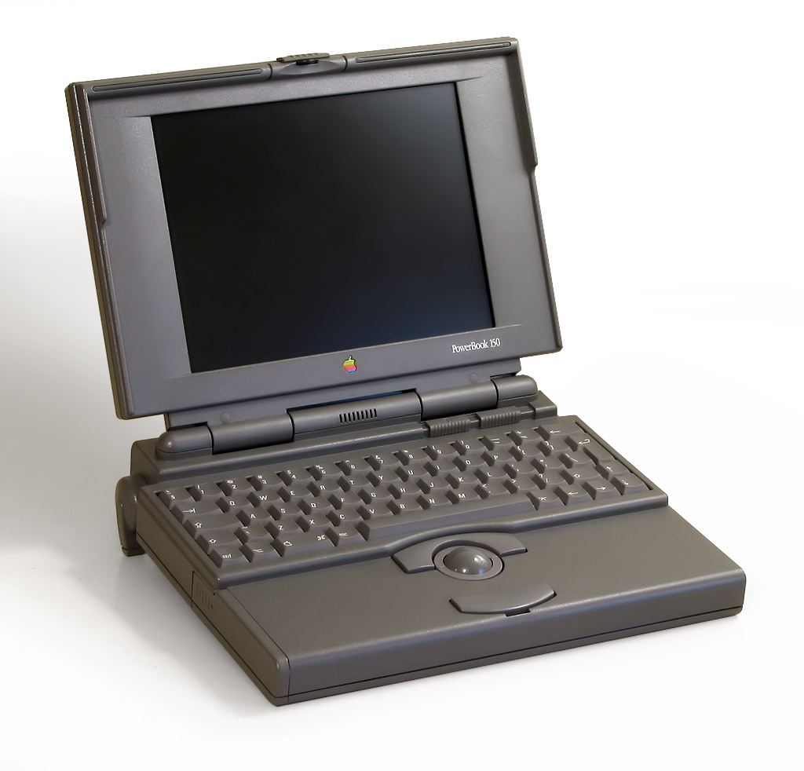
The Laptop
Machintosh Portable (1989)
Apple Powerbook (1991)

Slide 35
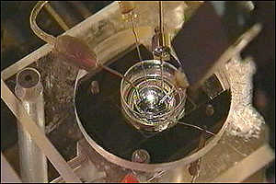
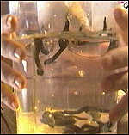
Biological Computer
Interconnected leech neurons. Georgia Institute of Technology, 1999

Slide 36
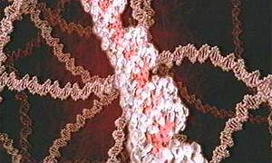
DNA Computer
Weizmann Institute of Science in Rehovot, Israel, 2002
And Stanford, 2013

Slide 37
Quantum Computers
Visual Capitalist March 14 2016

Slide 38
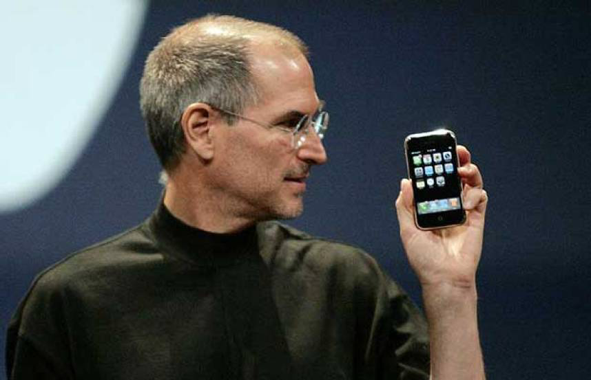
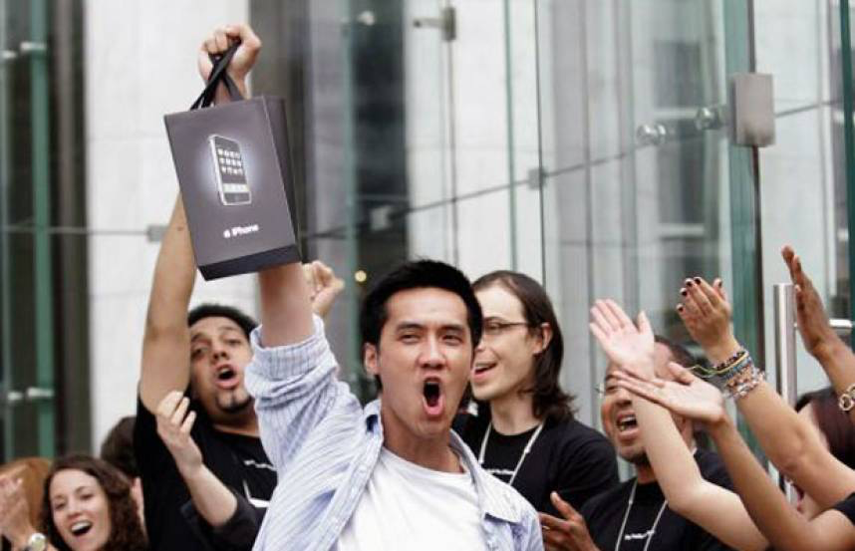
Smartphones
Steve Jobs (1955-2011)
One of the first iPhone buyers
iPhone June 2007

Slide 39
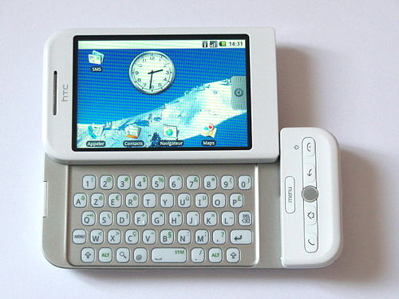
Smartphones
HTC Dream (Android) 2008

Slide 40
The INTERNET

Slide 41
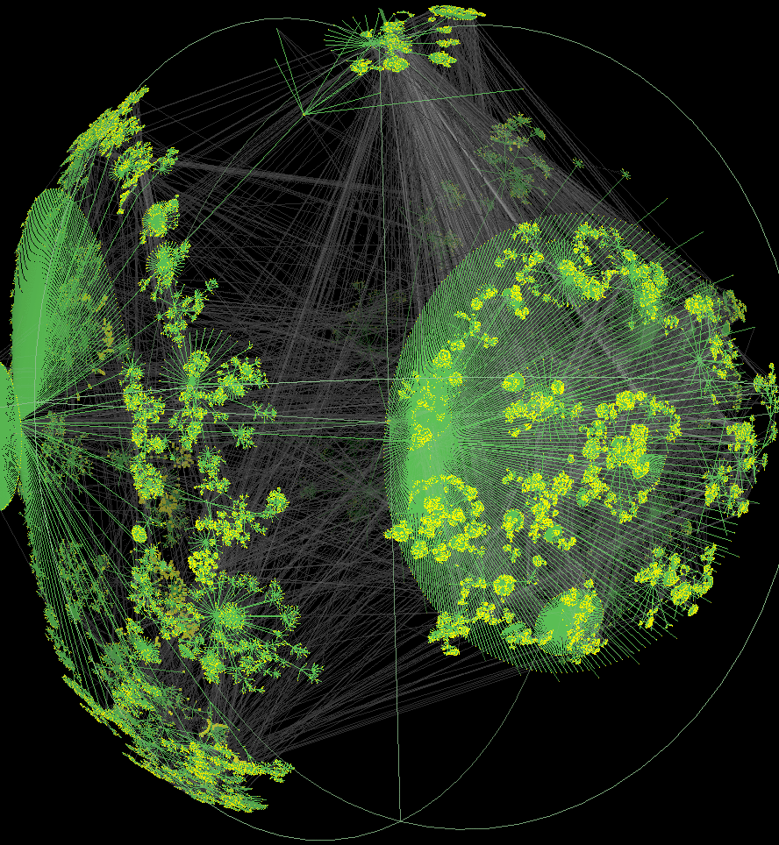
What is the Internet? A worldwide, publicly accessible series of interconnected computer networks

Slide 42
Why was the Internet invented?
Need:
A robust communication system that can withstand a nuclear attack and other harm.
Solution:
Send information in pieces that carry instruction on how they should be reassembled (“Packet Switching”)

Slide 43
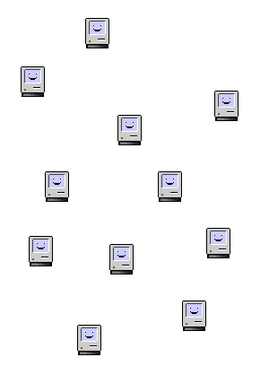
Packet Switching, 1962
Conceived by researchers in a collaboration between Universities (MIT, UCLA and others) and US Department of Defense (Defense Advanced Research Projects Agency).
Internet lore says that The Department of Defense wanted a communication system that could withstand a nuclear attack, but it was probably a more general need for a robust network that spurred the research.
If one ‘node’ in a network is destroyed the information should still reach its end destination.

Slide 44
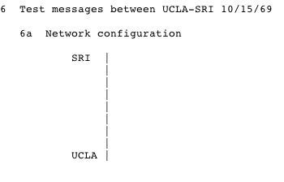
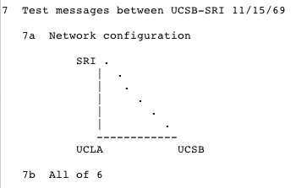
ARPANET, 1969
(Advanced Research Projects Agency Network of the United States Department of Defense)
Planning the first connection SRI to UCLA
UCSB was the 3rd node on the Internet! (Located in North Hall)

Slide 45
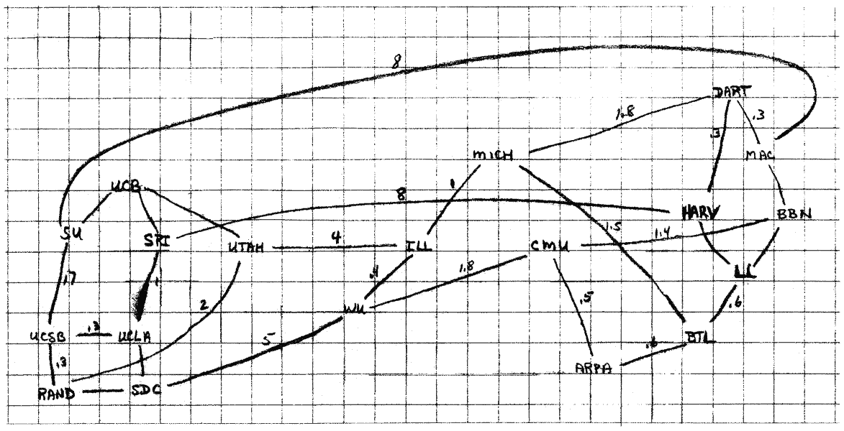
Planning the ARPANET in the late 60s

Slide 46
The WEB

Slide 47
What is the Web?
One specific way of communicating over the Internet. (Other ways of communication over the Internet includes email and SFTP)
HTTP - Hyper Text Transfer Protocol
A specific way to send data on the Internet. A client (a browser) request data from a server (a website).
HTML - Hyper Text Markup Language
For formatting and adding images and hyperlinks to text.

Slide 48
Why was the World Wide Web invented?
Need:
A way for people to easily share their research process and results.
Solution:
A protocol for how to format information and linking it together (HTML) and a protocol for how to use the Internet to send that information (HTTP)

Slide 49
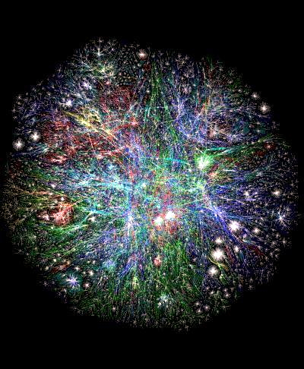
Tim Berners-Lee (b. 1955)
Conceived of the Web, and invented HTTP and HTML, while working at CERN (Conseil Européen pour la Recherche Nucléaire), Switzerland, in 1989.
“Inventing the World Wide Web involved my growing realization that there was a power in arranging ideas in an unconstrained weblike way”

Slide 50
The first webpage 1991 as seen in Lynx

Slide 51
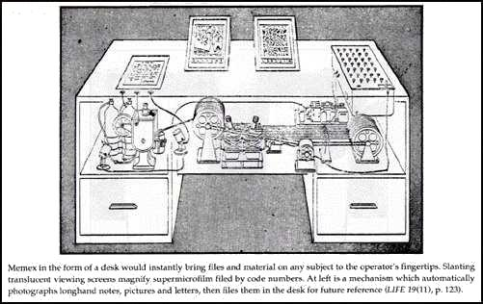
Memex (from As We May Think), Vanevar Bush 1945

Slide 52
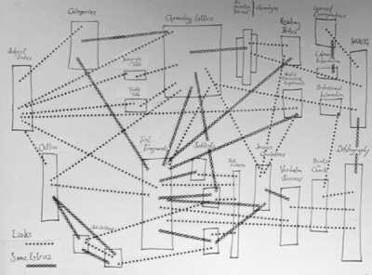
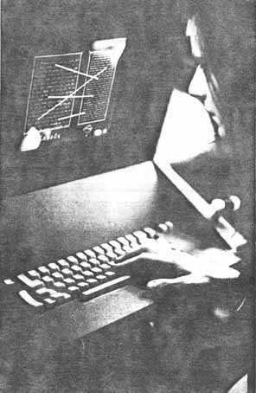
Theodore Nelson (b. 1937), Xanadu, 1963 (ongoing) Coined the word ‘Hypertext’.

Slide 53
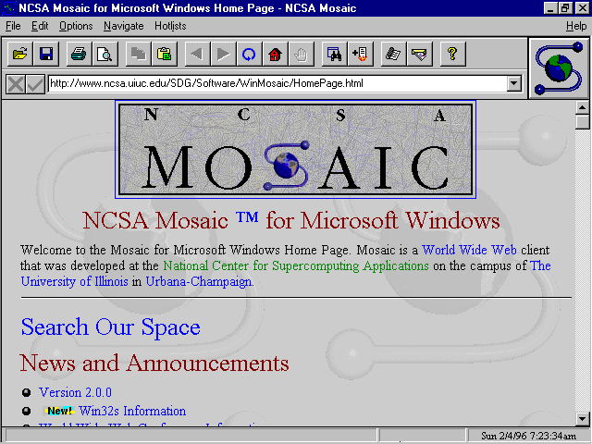
The first integrated text/image browser, Mosaic, launched in 1993.

Slide 55
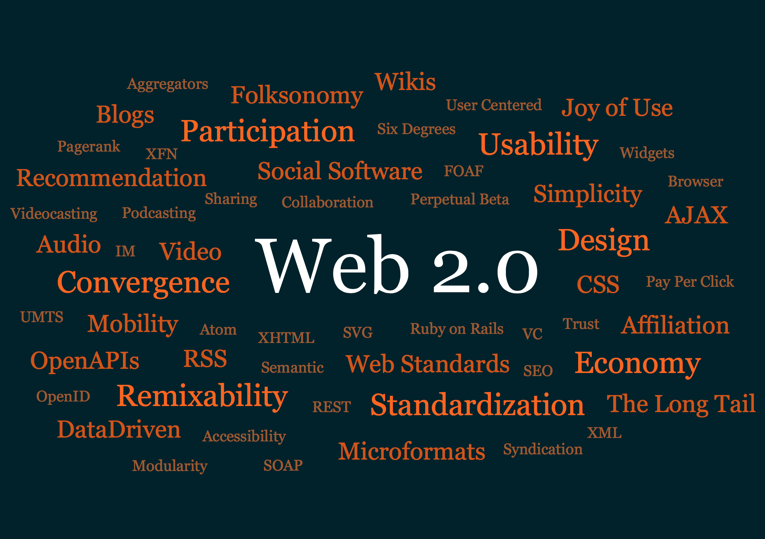
‘Web 2.0’ was coined in 1999.

Slide 56
‘Social Media’ (coined 1997, used extensively since 2008)
Interactive ‘Web 2.0’ Internet-based applications.
User-generated content, such as text posts or comments, digital photos or videos, and data generated through all online interactions, is the lifeblood of social media.
Users create service-specific profiles for the website or app that are designed and maintained by the social media organization.
Social media facilitate the development of online social networks by connecting a user's profile with those of other individuals or groups.

