Slide 1
Lecture Interaction
on your mobile go to
www.sli.do
Code for the lecture today: ilec1

Slide 2
‘I’ - Living and Creating in Systems/Networks
Social Networks, Identity, Privacy

Slide 3
White Spots, Richard Vijgen, 2016

Slide 4
Removed (2014), Eric Pickersgill

Slide 5
Removed (2014), Eric Pickersgill

Slide 6
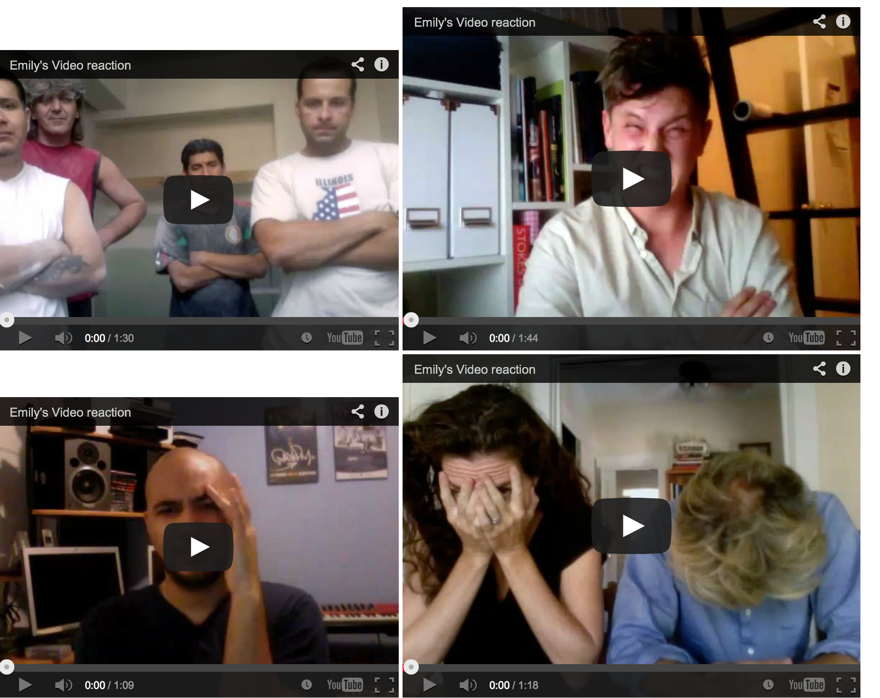
Emily's Video Eva and Franco Mattes (2012)

Slide 7
Identity

Slide 8
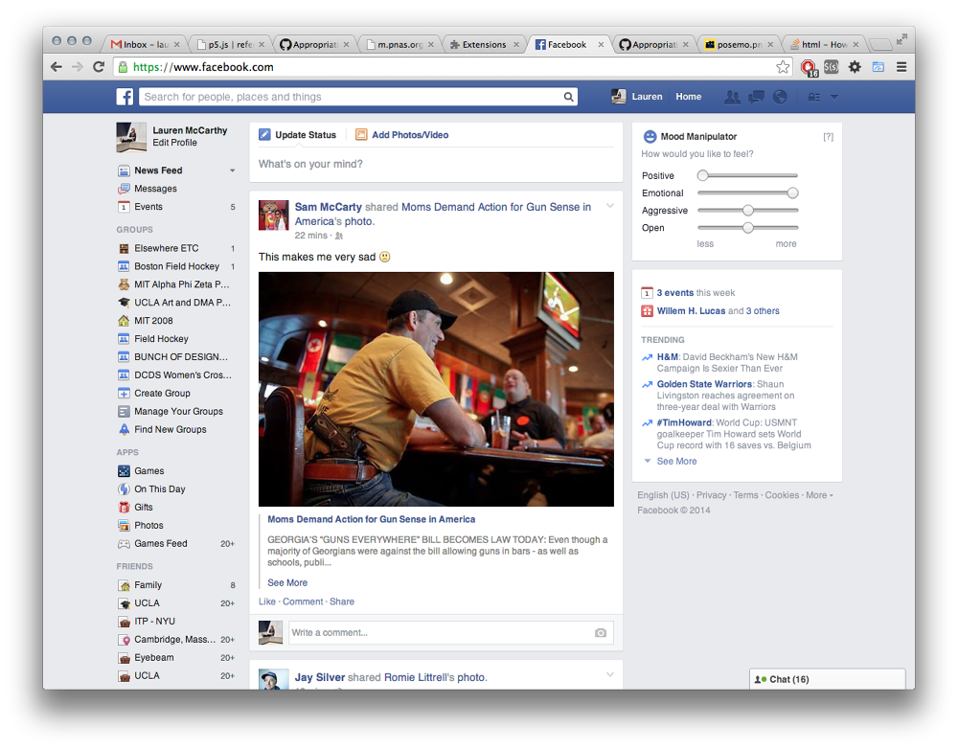
Facebook Mood Manipulator (2014), Lauren McCarthy

Slide 9
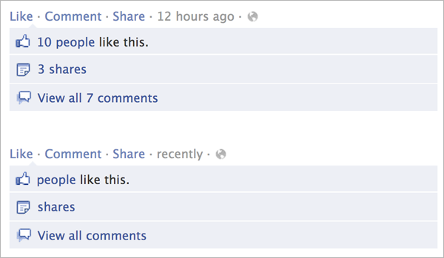
Facebook Demetricator (2012), Ben Grosser (see this weeks reading)

Slide 10
Bliss, Anthony Antonellis (2012)

Slide 11
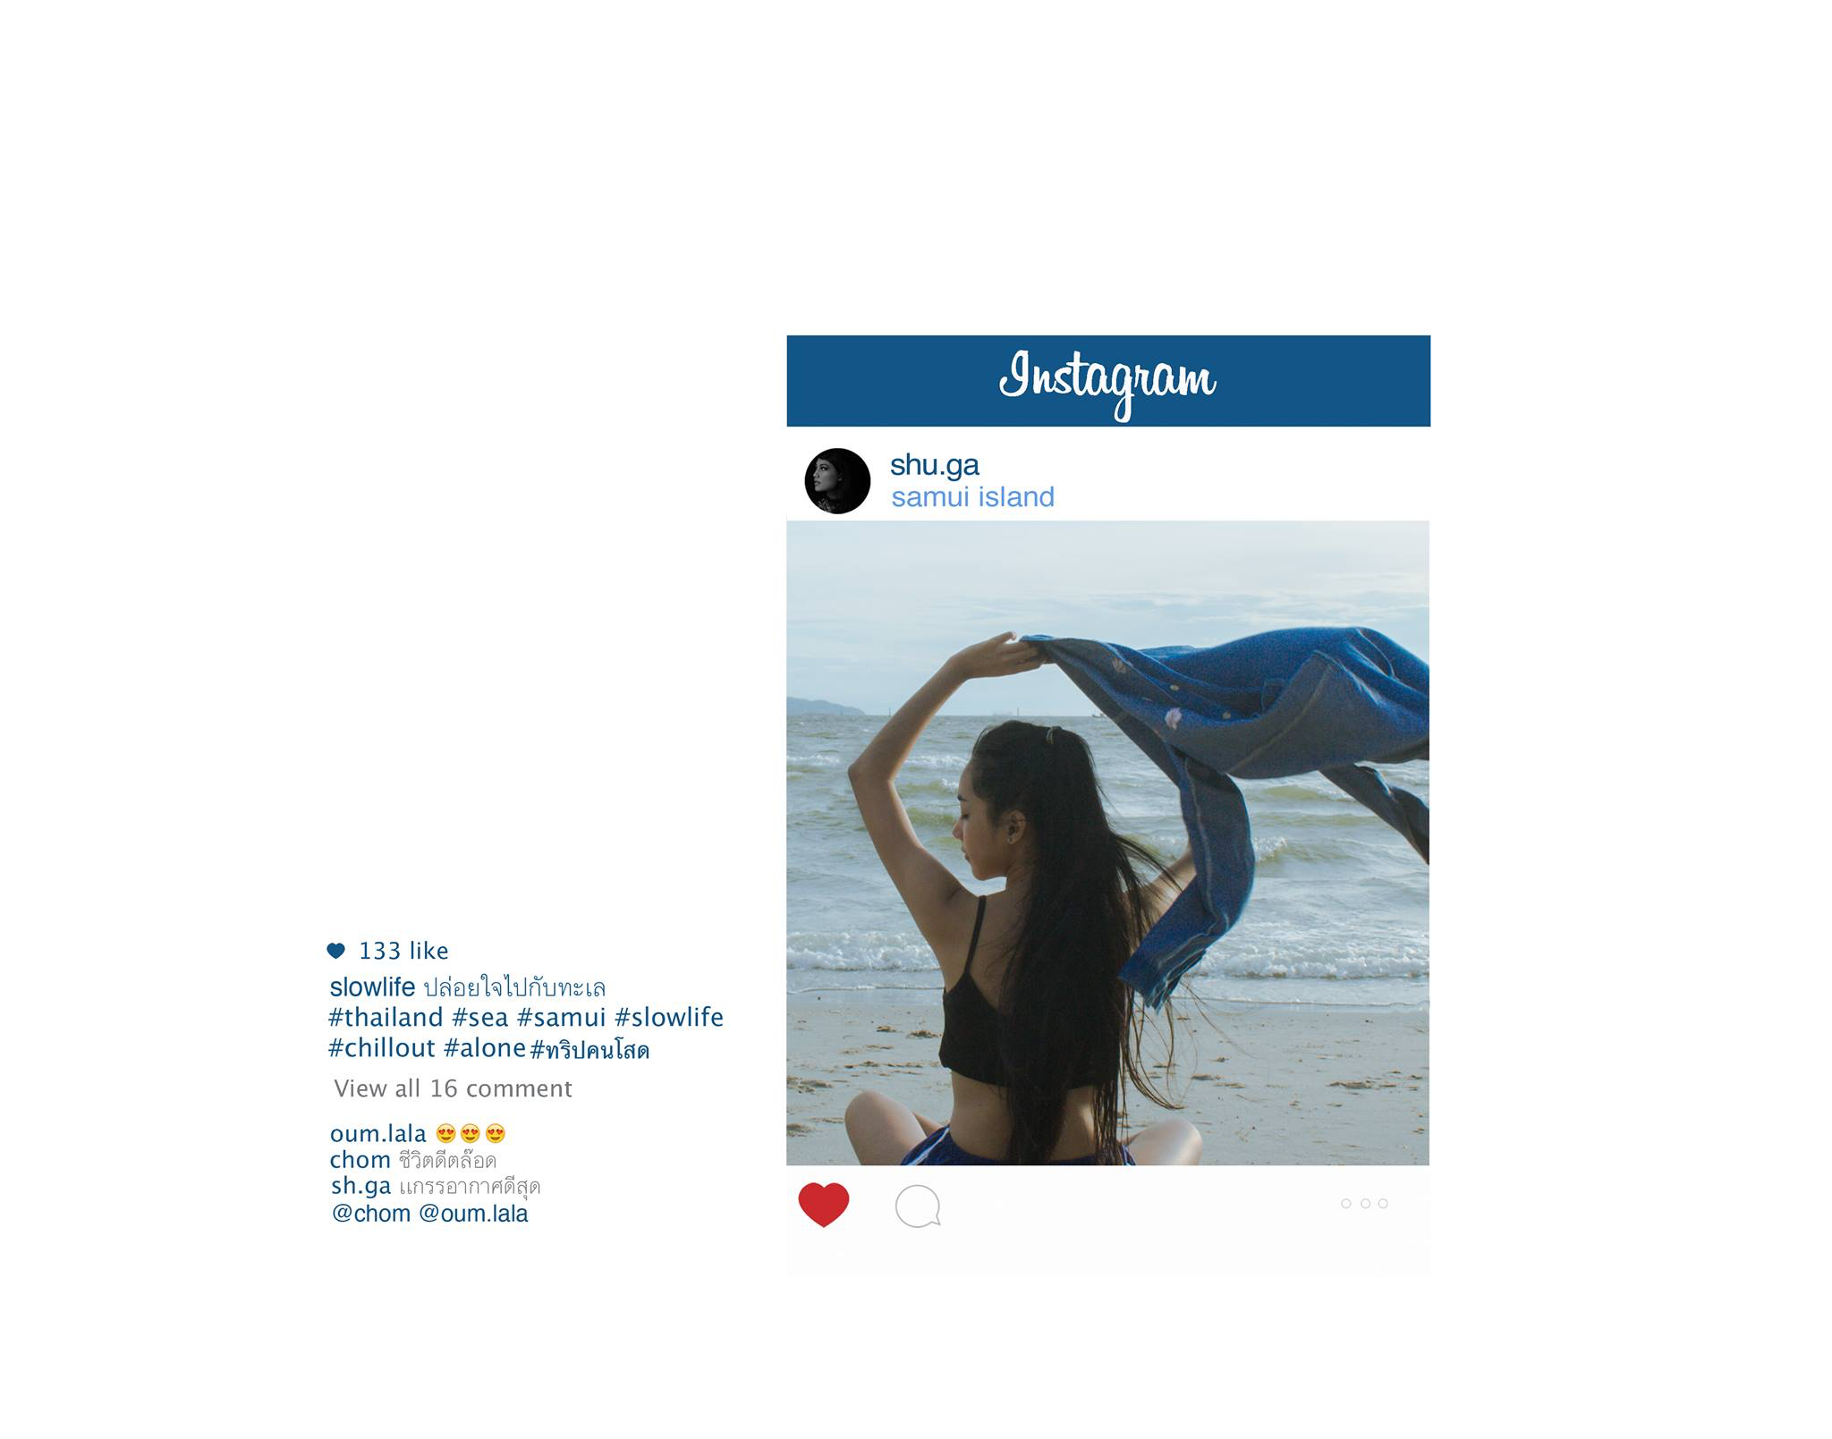
#IAMNOTFAMOUSANYMORE, Shia LaBeouf, 2014
#slowlife (2015), Chompoo Baritone

Slide 12
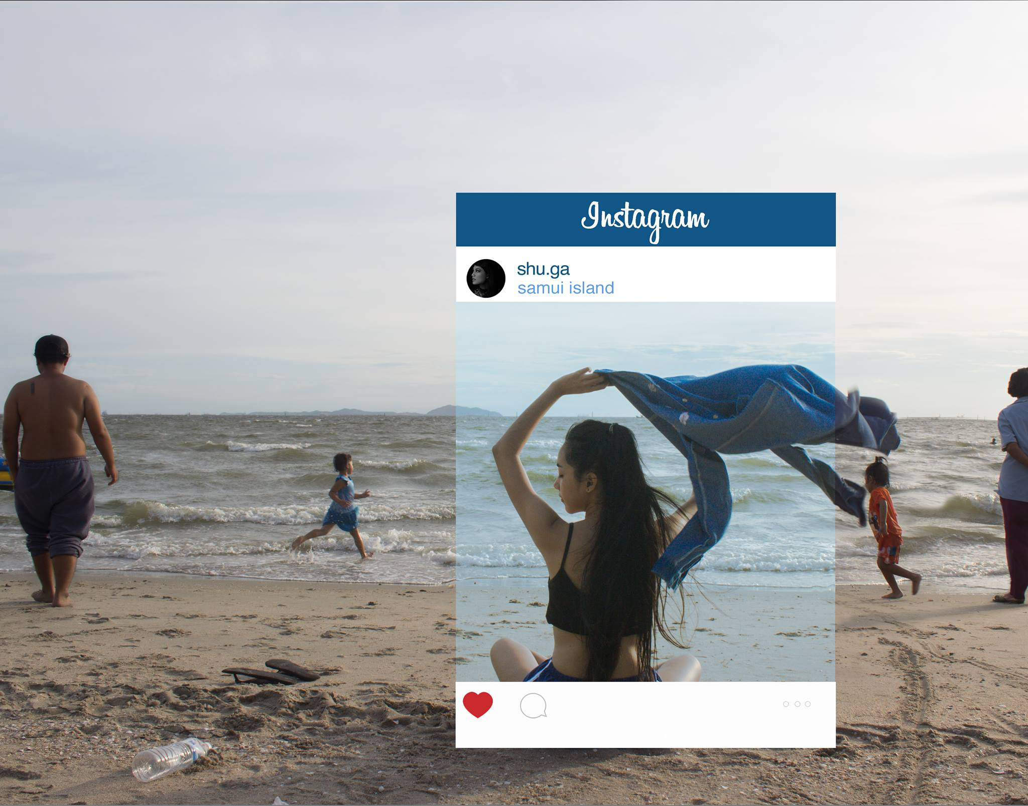
#IAMNOTFAMOUSANYMORE, Shia LaBeouf, 2014

Slide 13
Chompoo Baritone

Slide 14
Chompoo Baritone

Slide 15
Chompoo Baritone

Slide 16
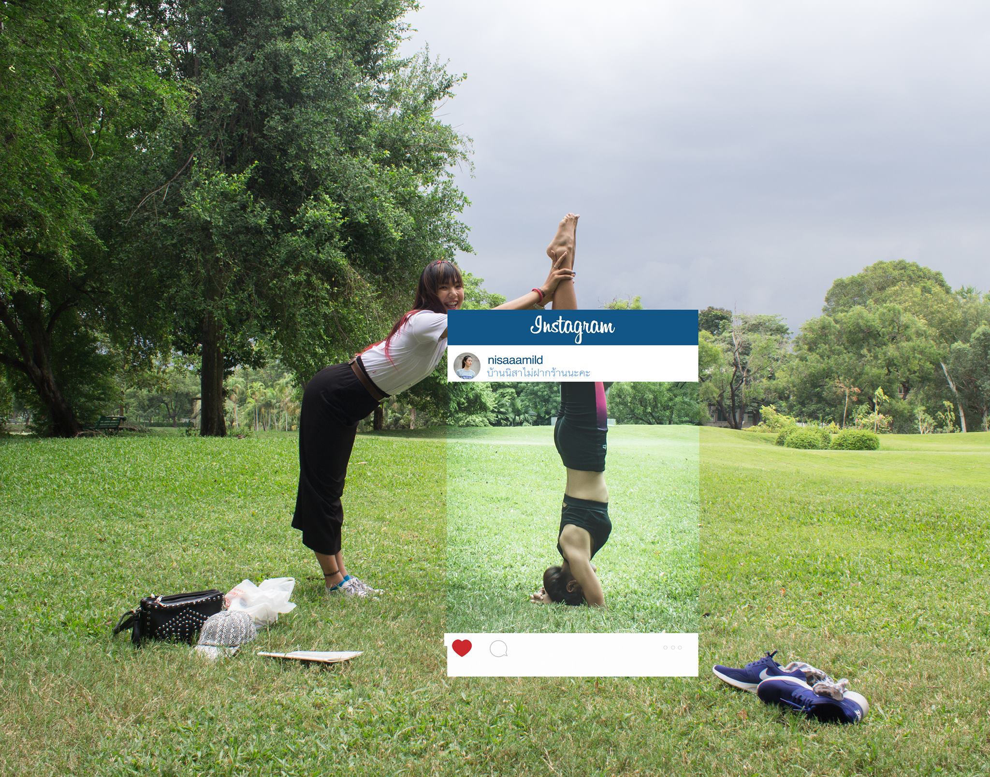
Chompoo Baritone

Slide 17
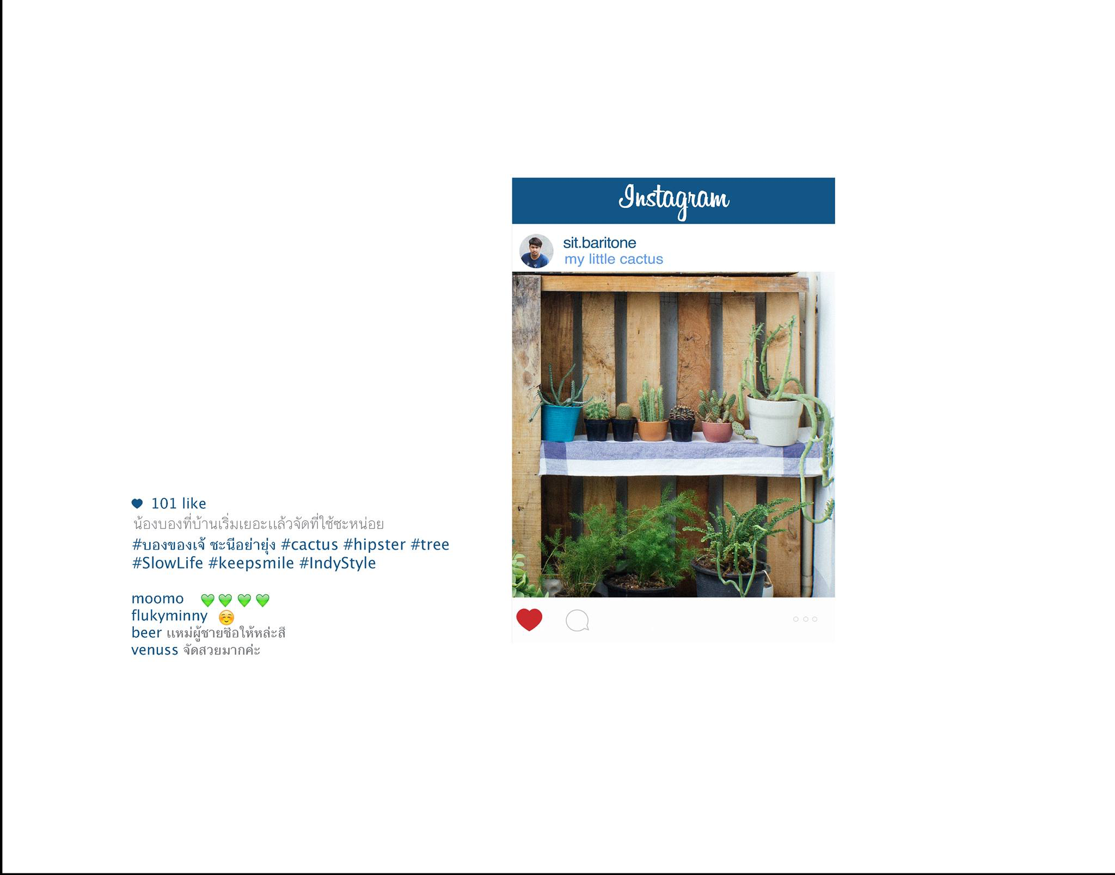
Chompoo Baritone

Slide 18
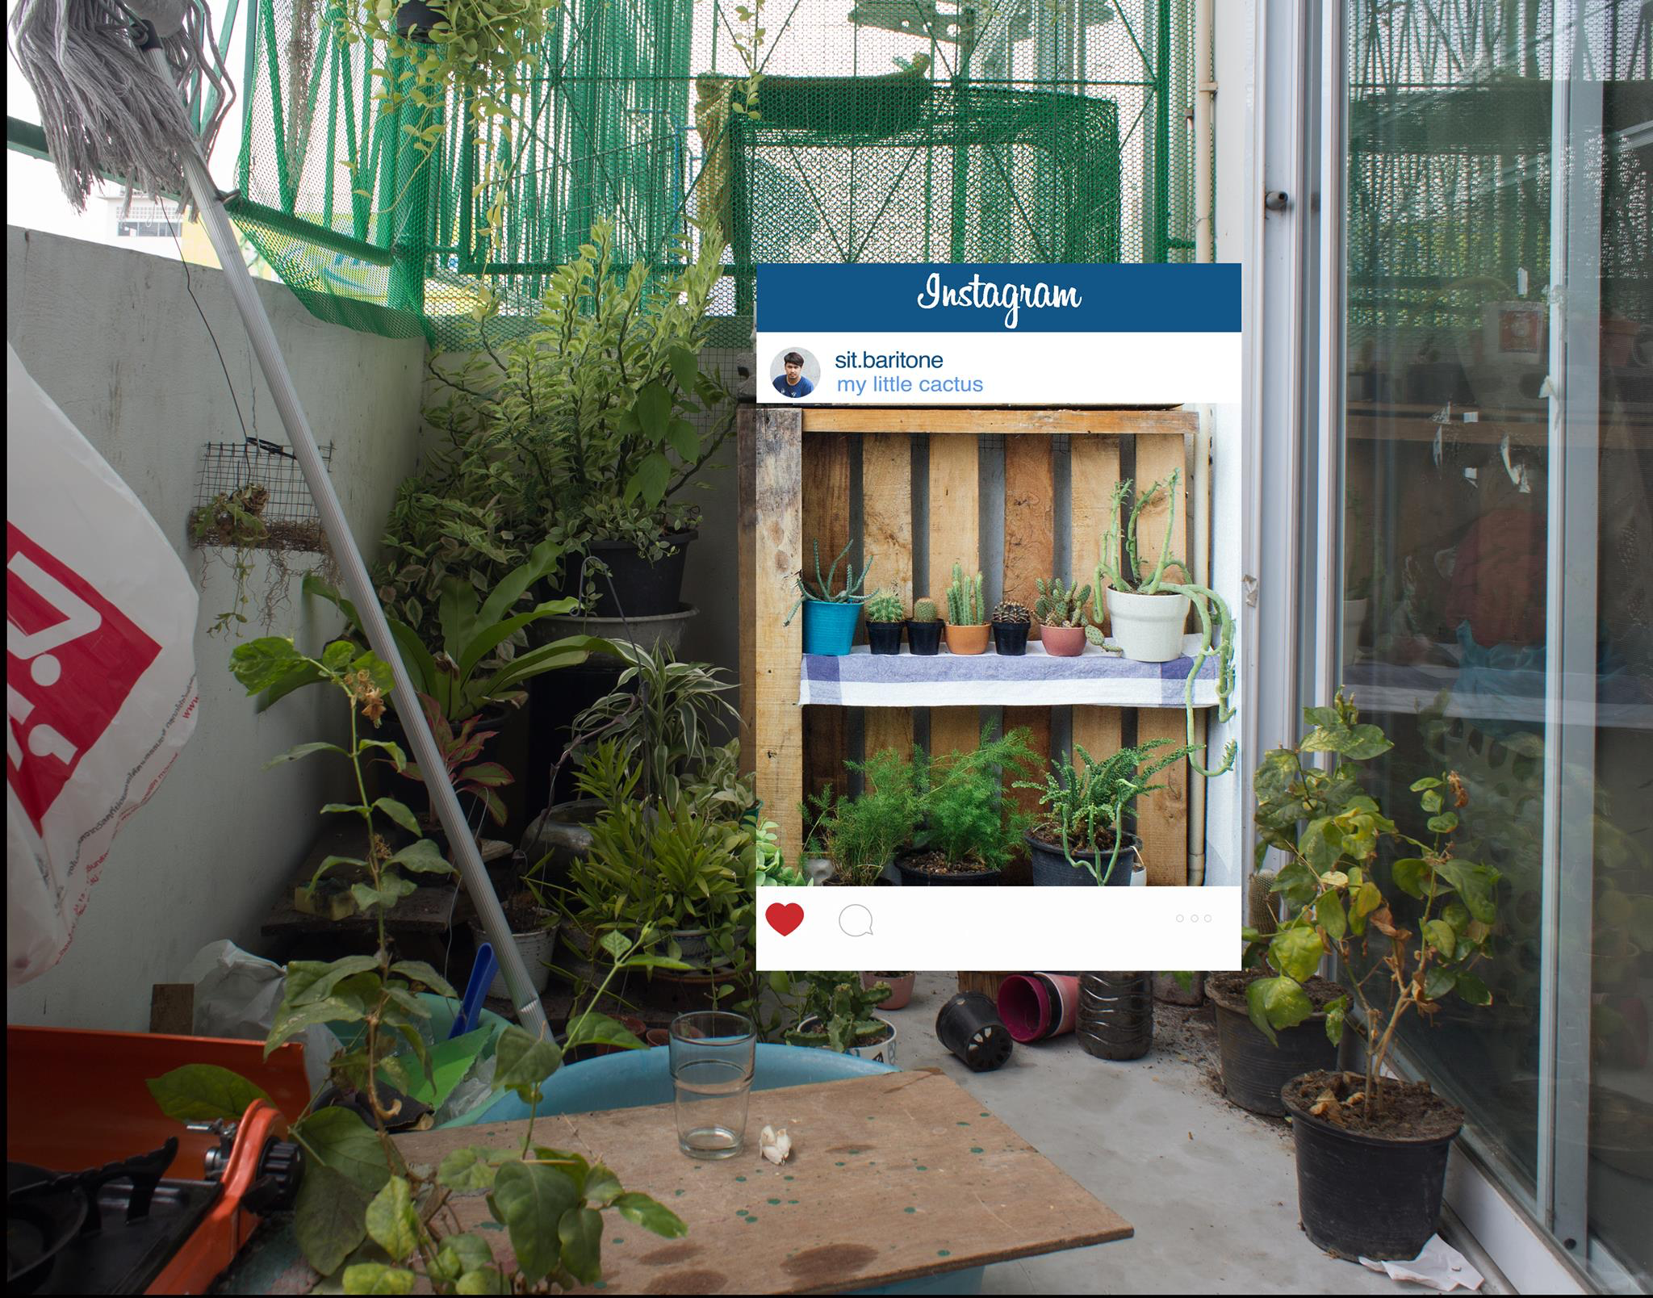
Chompoo Baritone

Slide 19
Cory Arcangel, Akron - Cincinnati (2012)
;********************************************************
;
; Akron --> Cincinnati
;
; Cory Arcangel - 2012
;
; http://www.coryarcangel.com/
;
; "I like Nine Inch Nails, and I like hip-hop. " - Axl Rose
;
;********************************************************
A perl driven Twitter bot which automatically posts status updates in the common "travel" (city --> city) format, to make it look like the user spends alot time in, and flying between random mid-western cities.

Slide 20
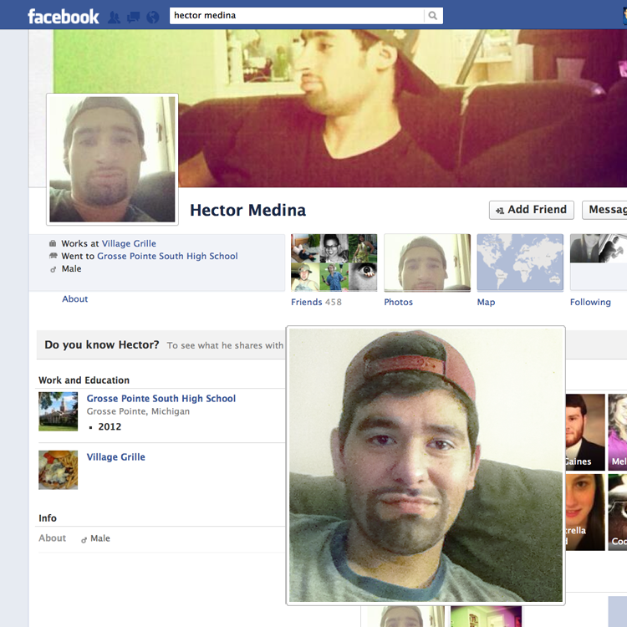
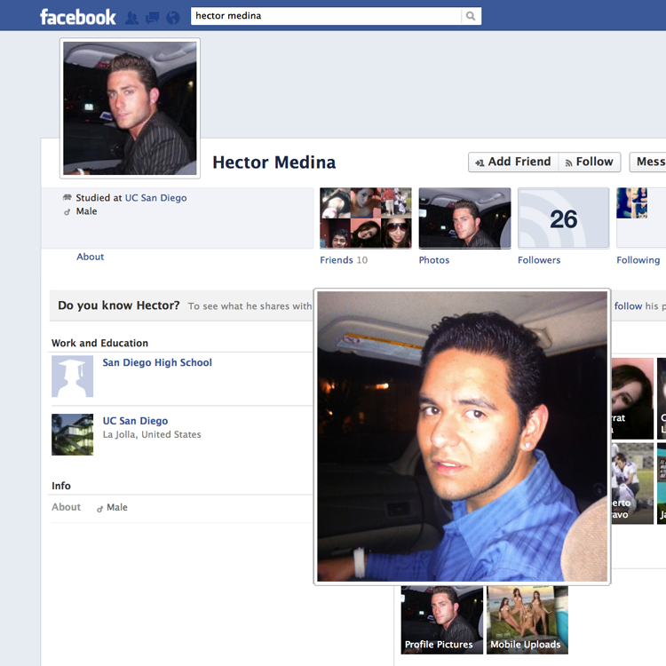
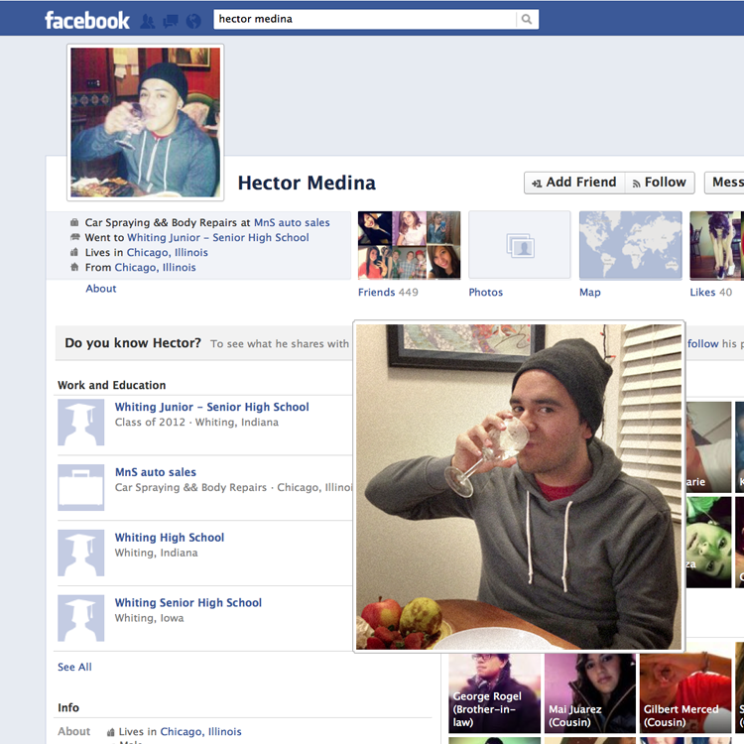
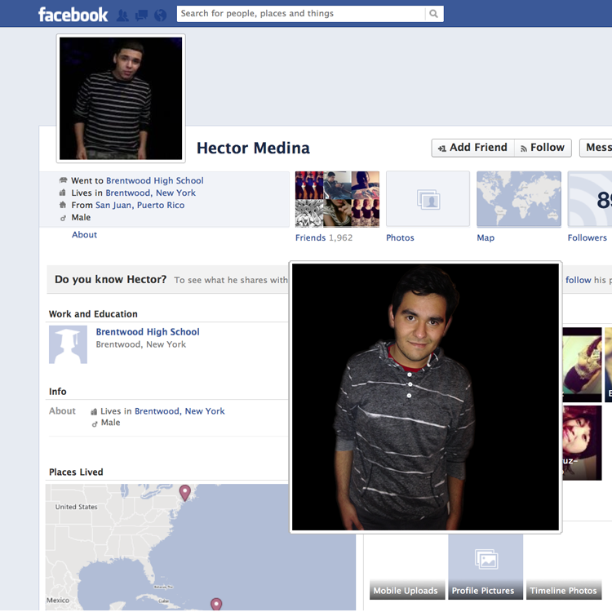
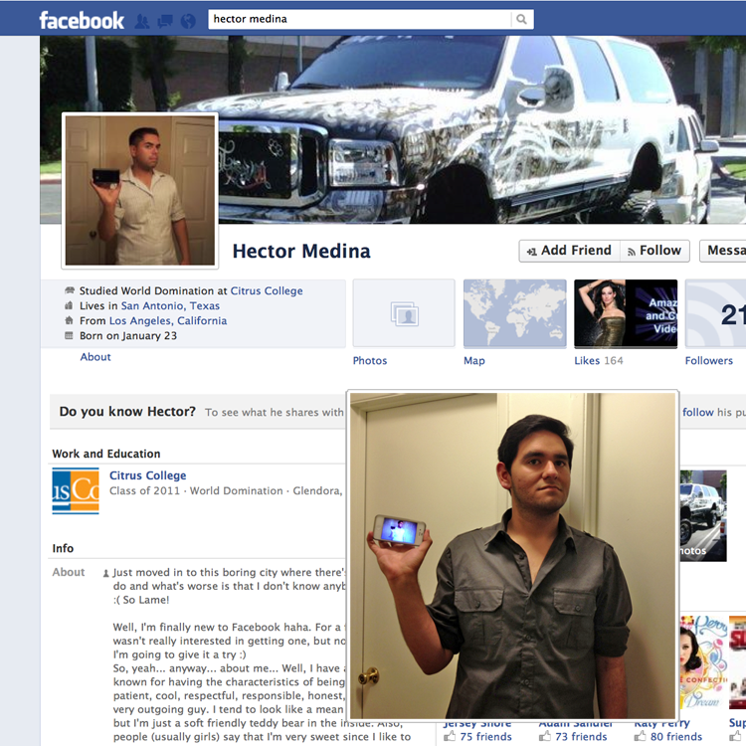
Hector Medina (Art 7D student 2013)

Slide 21
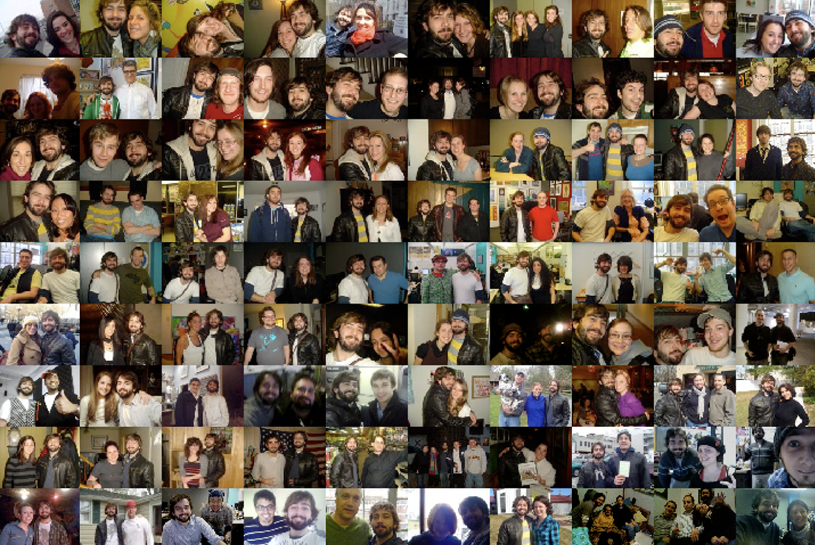
Digital Painting-Social Network and The Facebook Road Trip Graham Smith 2011

Slide 22
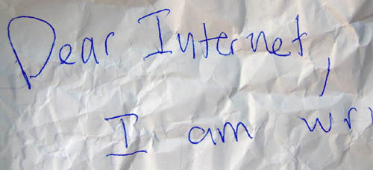
Friendster Suicide Live in Person, Cory Arcangel, 2005

Slide 23
Privacy

Slide 24
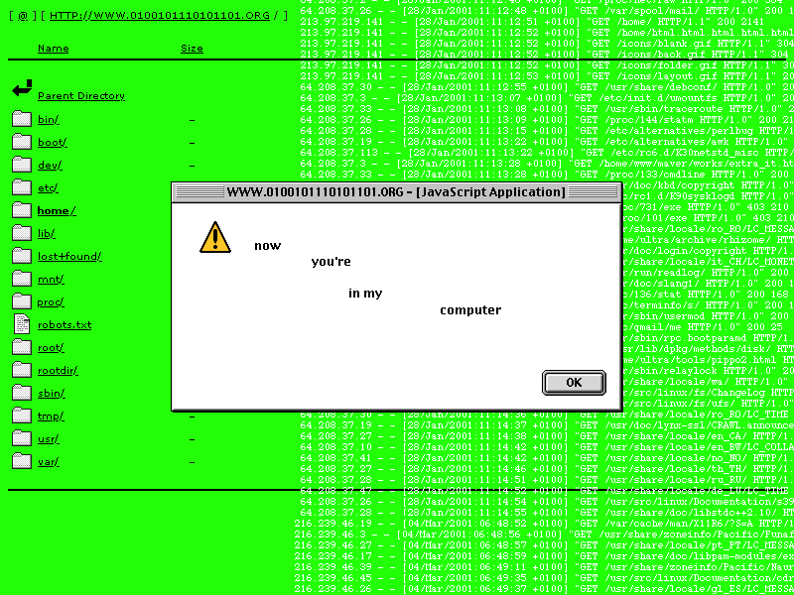
Life Sharing, 2000-2003, Walker Art Center, by 0100101110101101.ORG (Eva and Franco Mattes)

Slide 25
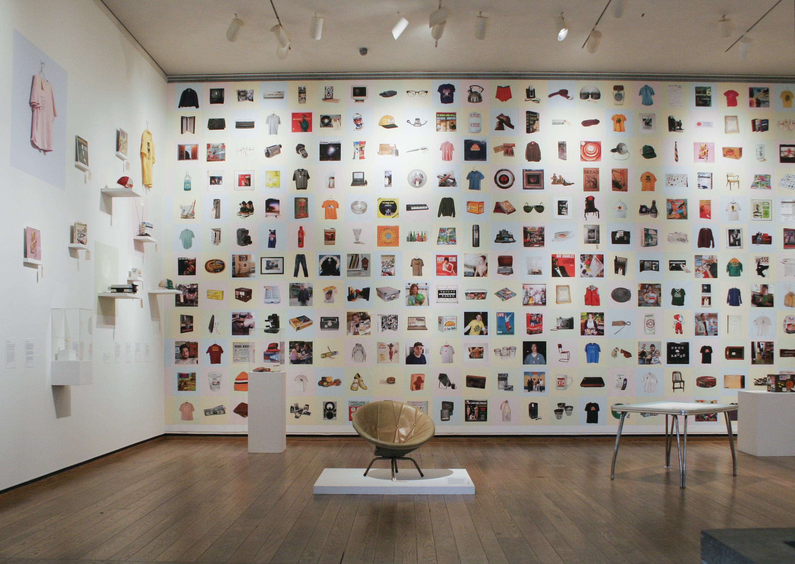
All my life for sale (2001) John D Fryer

Slide 26
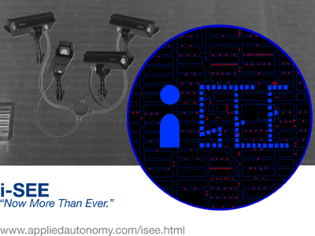
iSee, Institute for Applied Autonomy (2001)

Slide 27
People Staring At Computers (2011), Kyle McDonald Article in Wired

Slide 28
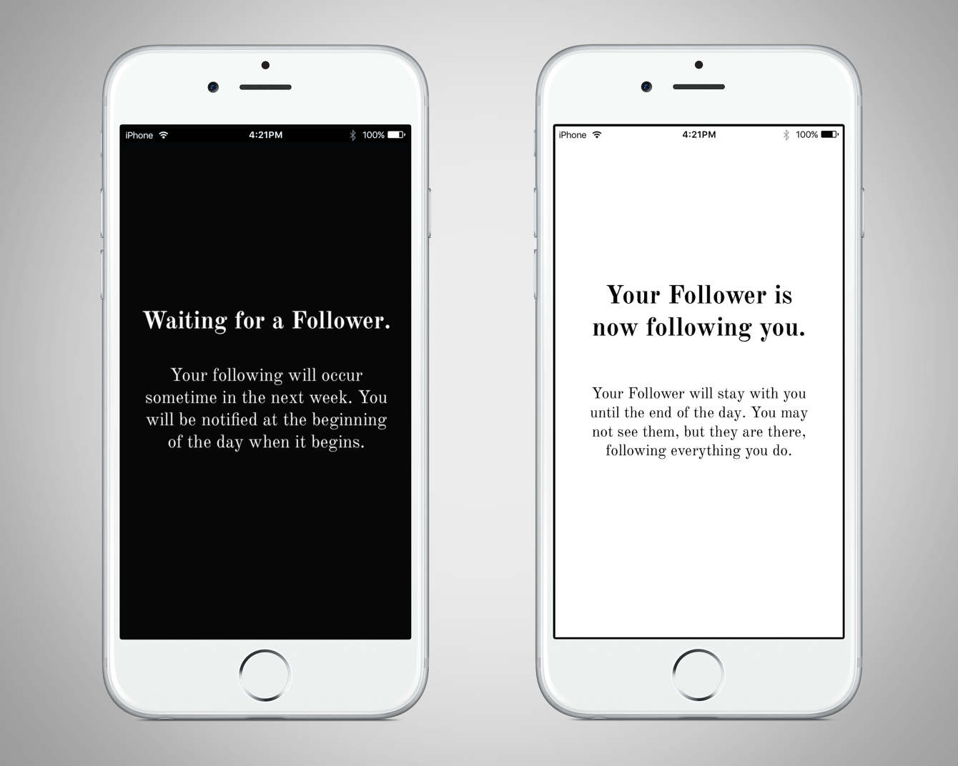
Follower (2016), Lauren McCarthy

Slide 29
Video
Video 2
Hansel & Gretel, Ai Weiwei and Herzog & de Meuron, 2017

