Slide 1
WELCOME Art7D 2020! Lecture Attendance: Please get app from arkaive.com Enrollment Code:

Slide 2
Lecture Interaction
On your mobile device go to:
www.sli.do
Code for the lecture today: L01

Slide 3
Period 1
Computer and Media Art History
Computer, internet and digital art history overview
and intro to HTML

Slide 4
Period 2
Investigations – Science/World
Investigating the world around us
Art/Science, Performative Science, Citizen Science, Biohacking, Environmental Art, The Anthropocene, Data Visualization

Slide 5
Period 3
I – Subjects/Mind
Being a person in a world saturated with technology
Social Networks, Identity, Privacy, Cybercrime, Hacking, Avatars, Artificial Intelligence, Games

Slide 6
Period 4
Inventions – Objects/Body
The stuff we make to help us interact with, negotiate and use the world around us.
Kinetic Art, Machines and Devices, Robotic Art, Electronics, Micro-controllers, Sensors, Cyborgs

Slide 7
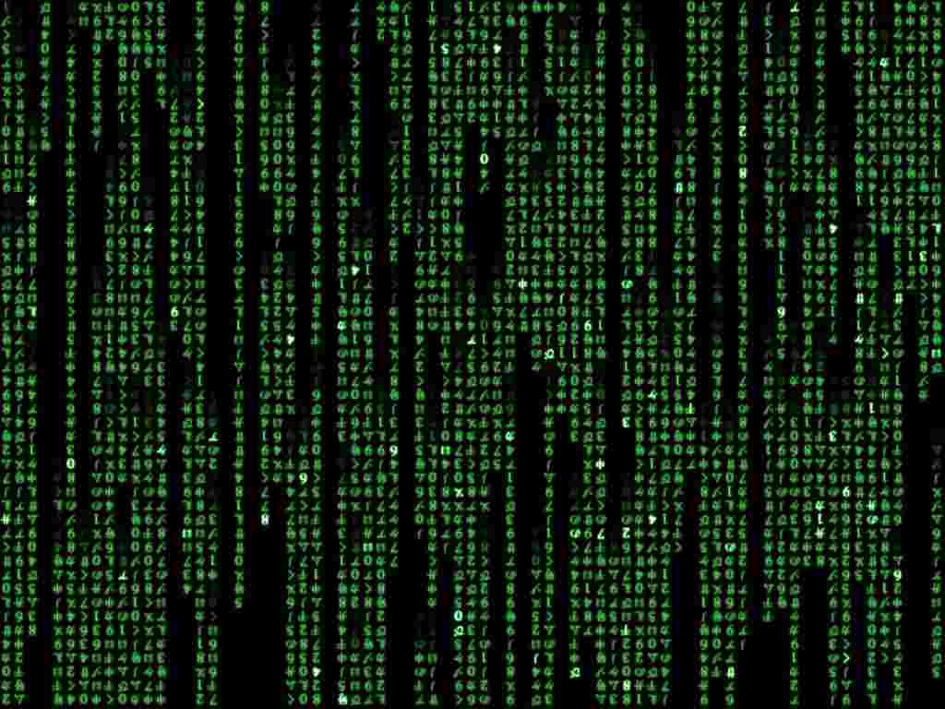
Computer layers
Apps and Software: Photoshop, Microsoft Word, Firefox, Snapchat
Code: Formatting Languages – HTML, CSS
Code: Programming Languages – JavaScript, Processing
Code: Programming Languages – C, C++
Code: Assembly Language
Code: Machine Language
Electrical Circuits with On/Off Switches (Ones and Zeroes)

Slide 8
“The medium is the message” (Writer/Theoretician Marshall McLuhan, 1964)

