Slide 1
‘Inventions’ - Machines and Devices

Slide 2
Kinetic Art

Slide 3
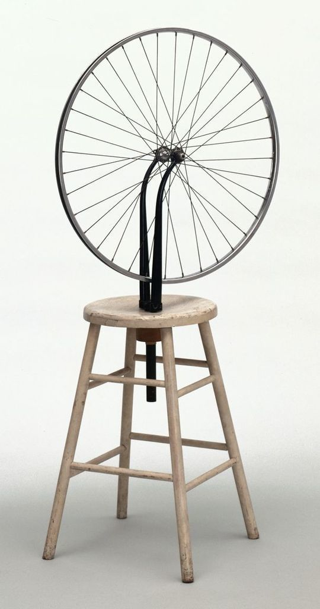
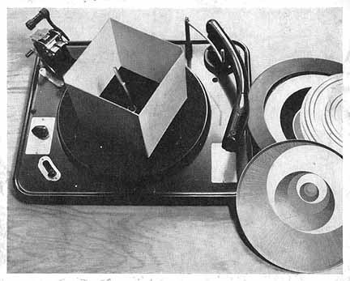
Marcel Duchamp (1887 – 1968)
Rotorelief 1935-1953
Bicycle Wheel, 1913

Slide 4
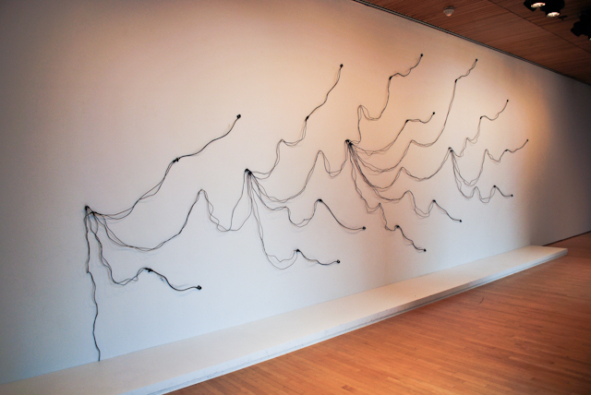
Night-Sea Music, Ed Osborn (1998/2012)

Slide 5
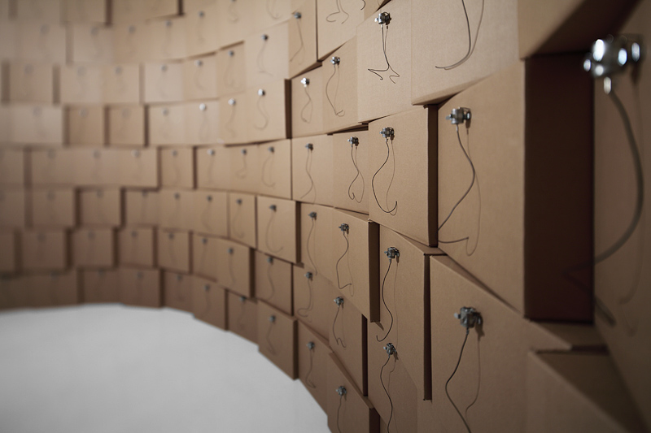
236 prepared dc-motors, wire isolated, cardboard boxes 41x41x41cm, Zimoun 2011

Slide 6
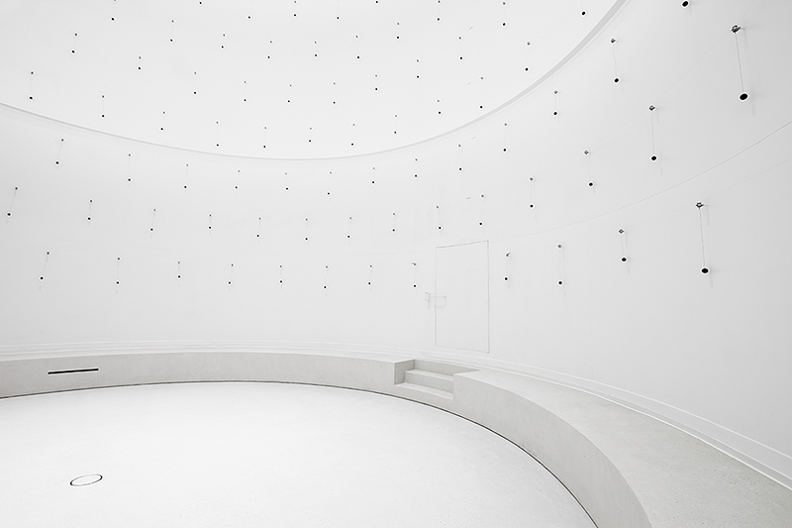
329 prepared dc-motors, cotton balls, toluene tank, Zimoun 2013

Slide 7
Drawing Robots

Slide 8
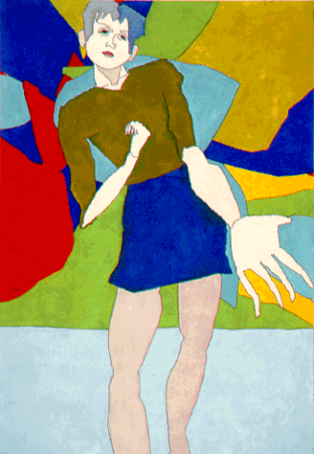
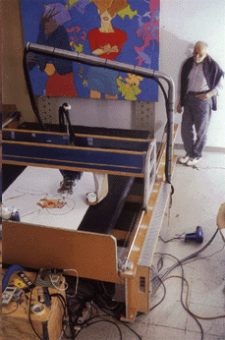
Aaron (1979) Harold Cohen (1928-2016)

Slide 9
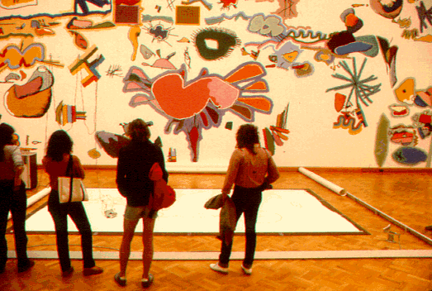
Aaron at San Francisco Museum of Modern Art (1979), Harold Cohen
Video

Slide 10
Drawing Robots 5RNP (2015), Patrick Tresset

Slide 11
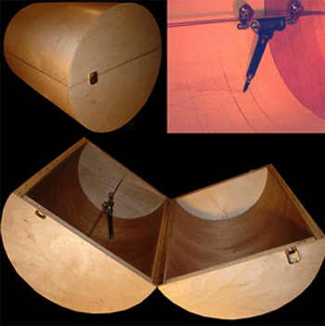
Drawing Machine 10, Brian DeRosia (2000)

Slide 12
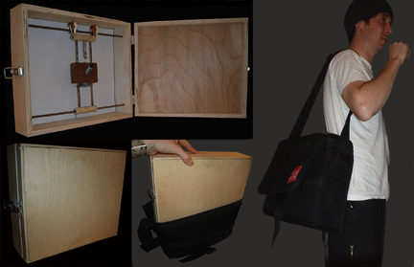
Drawing Machine 8, Brian DeRosia (2000)

Slide 13
Drawing Machine 8, Brian DeRosia (2000)
Drawing Machine 10, Brian DeRosia (2000)
Drawing App, Brian DeRosia (2014)

Slide 14
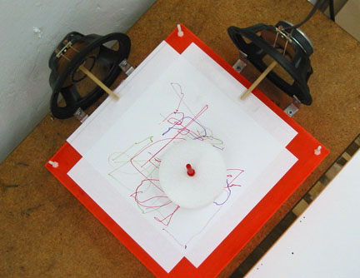
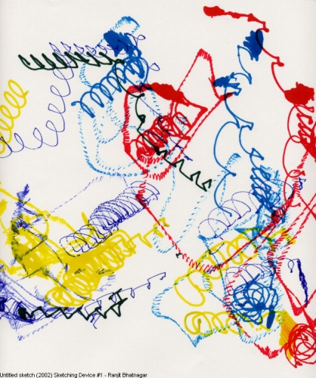
Sketching device #1 (2002), Ranjit Bhatnagar

Slide 15
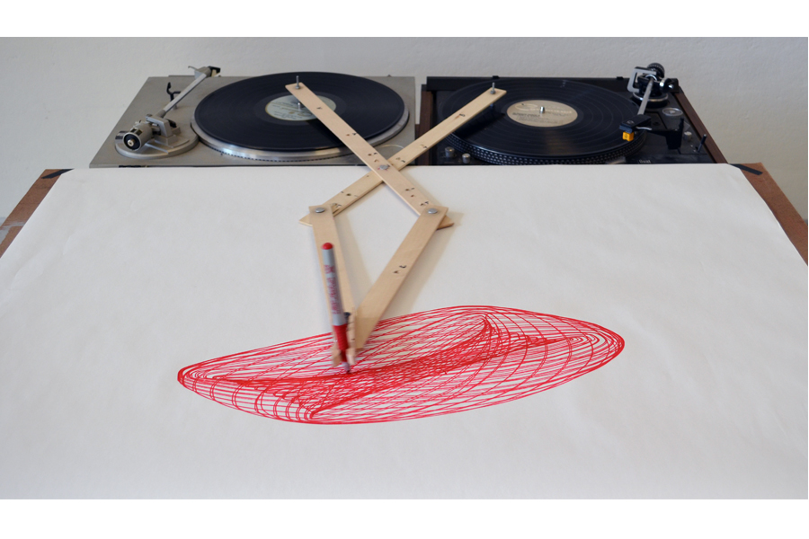
Robert Howsare, Drawing Apparatus, 2012

Slide 16
(Strange) Devices and Speculative Design

Slide 17
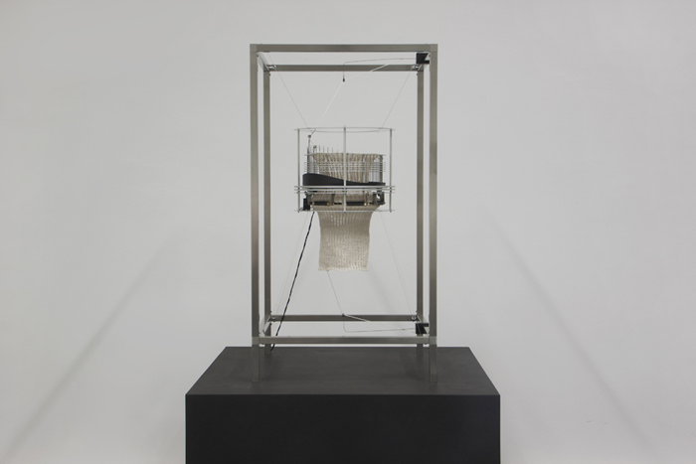
Imagine Sisyphus Happy (2013), Joanna Dauner and Marjam Fels

Slide 18
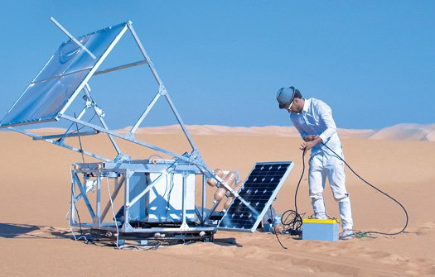
Solar Sinter (2011), Marcus Kayser

Slide 19
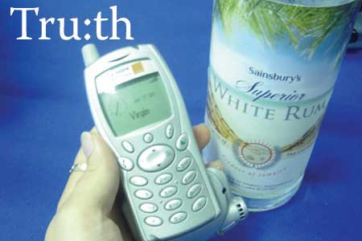
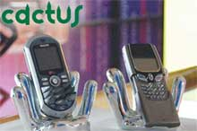
Hwa Young Jung in collaboration with Somet;ng (2006)
Tru:th Phone “Not being able to see them, it's hard to judge others' emotions over the mobile. This model makes phone calls only if one is intoxicated, ensuring nothing but communication from the drunken heart.”
Cactus Phone has had the buttons on its keypad replaced with razor-sharp needles. On the surface, it may be seen as a masochistic fetish object or designed to prevent its use. Calls can become more meaningful when the other knows you are enduring physical pain to talk to them.

Slide 20
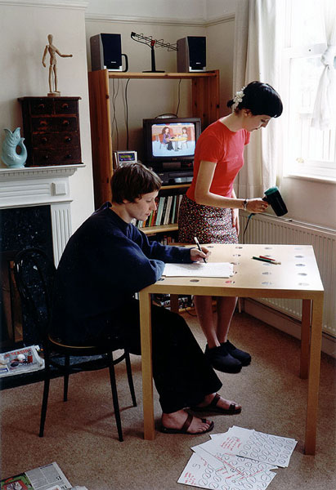
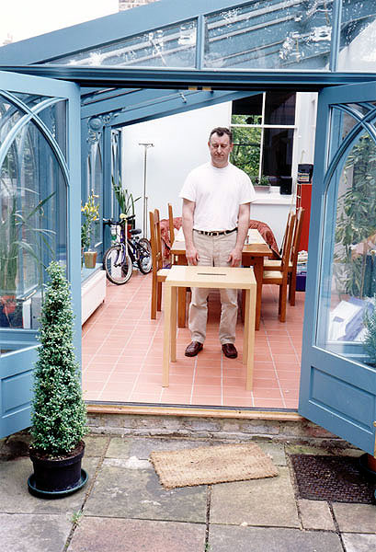
Fiona Raby and Anthony Dunne, GPS Table (2001)
Fiona Raby and Anthony Dunne, Compass Table (2001)

Slide 21
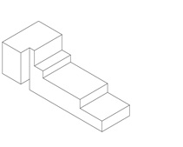
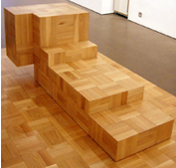
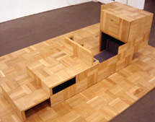
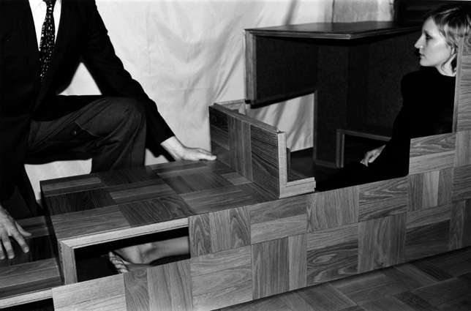
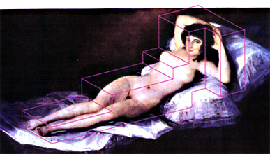
Michael Anastassiades, Anthony Dunne and Fiona Raby Hide Away Furniture (2003)

