Slide 1
WELCOME Art7D 2020! Lecture Attendance: Please get app from arkaive.com

Slide 2
Period 2
Investigations – Science/World

Slide 3
1/23 Lecture 3: ‘Investigations’ 1
Week 4 Sections:
M 1/27, T 1/28: Class Activity
W 1/29, TR 1/30: ‘Investigations’ Reading Due. Reading discussion, work on projects
1/30 Lecture 4: ‘Investigations’ 2
Week 5 Sections:
M 2/3, T 2/4: Work on projects.
W 2/5, TR 2/6: ‘Investigations’ Project Due. Project critique.

Slide 4
Lecture Interaction
on your mobile go to
www.sli.do
Code for the lecture today: lec3

Slide 5
Art and Science: Differences
Epistemology: How can/do we know things?
Science: There is a reality separate from us and by using the right methods we can learn the true facts of that reality.
Art: Reality is what we perceive. There are no methods that are not “tainted” by their context. The way we are looking at something will change it.
Qualitative vs. Quantitative data:
Science: Tend to favor quantitative data (numerical, possible to make calculations on)
Art: Tend to favor qualitative data (not numerical, statements, observations, opinions)

Slide 6
Art and Science: Similarities
Creativity
Use of technology
Rigorous methodology
Observations
Experimentation
Categorizing
Questioning

Slide 7
The Scientific Method
Techniques for investigating phenomena, acquiring new knowledge, or correcting and integrating previous knowledge, based on gathering observable, empirical and measurable evidence subject to specific principles of reasoning.
The collection of data through observation and experimentation, and the formulation and testing of hypotheses.
Scientific researchers propose hypotheses as explanations of phenomena, and design experimental studies to test these hypotheses. These steps must be repeatable in order to dependably predict any future results.
Procedures vary from one field of inquiry to another.

Slide 8
The Scientific Method

Slide 9
The Scientific Method

Slide 10
What is the Artistic Method?

Slide 11
Lecture Interaction
on your mobile go to
www.sli.do
Code for the lecture today: lec3

Slide 12
How can artists contribute to science?
“PERFORMATIVE SCIENCE”
To make understandings of complex systems it might be more suitable to work with open-ended experiential methods such as performance.

Slide 13
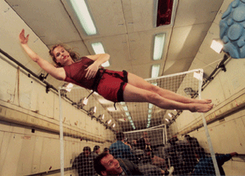
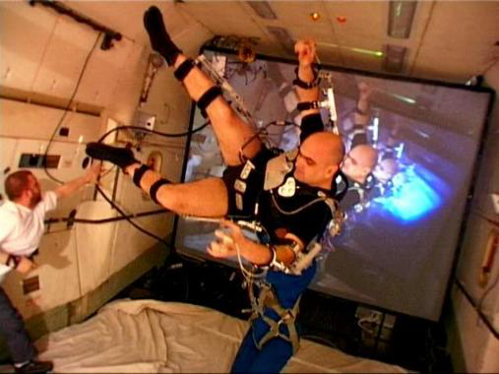
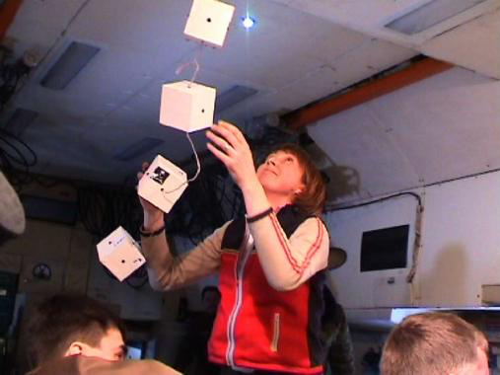
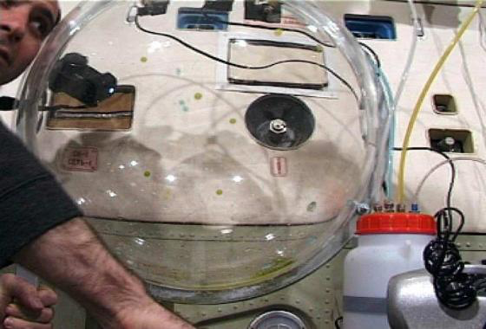
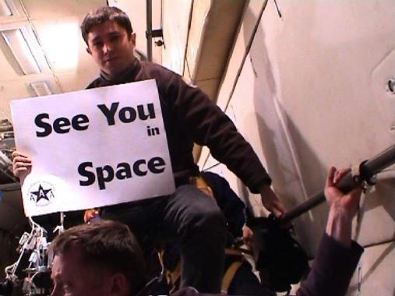
M.I.R. (Microgravity Interdisciplinary Research (2001-2003)

Slide 14
https://www.youtube.com/watch?v=vB6n4nZOQOo
M.I.R. (Microgravity Interdisciplinary Research (2001-2003)

Slide 15
iMAP (Interdisciplinary Mobile Architecture and Performance)/Ridgewood Reservoir (2007) Choreographer Jennifer Monson, architect Gita Nandan and landscape architect Elliott Maltby of thread collective, and composer Kenta Nagai

Slide 16
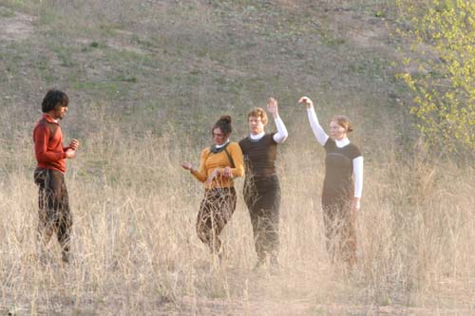
Bird Brain Dance, Jennifer Monson (2001-2006)
The parallels Ms. Monson has found between animal navigation and dancing continue: she likens the mind itself to a navigating beast and the body's separate muscular and energy ''systems'' to the territories it passes through. She has devised a special mode of imaginative travel from organs through muscle to skin and finally outward to other bodies and their surroundings. NY Times 2001

Slide 17
How can artists contribute to science?
AUDIENCE INVOLVEMENT
Artists often involve their audience in their projects/research. For example audience members are provided hands on experiences of abstract phenomena.

Slide 18
Ned Kahn (1960)

Slide 19
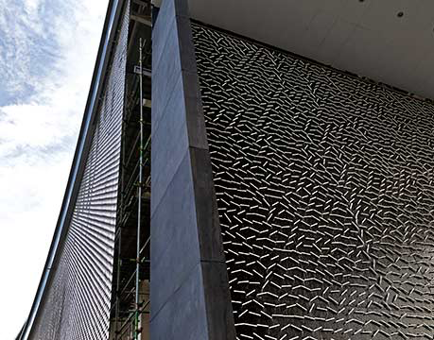
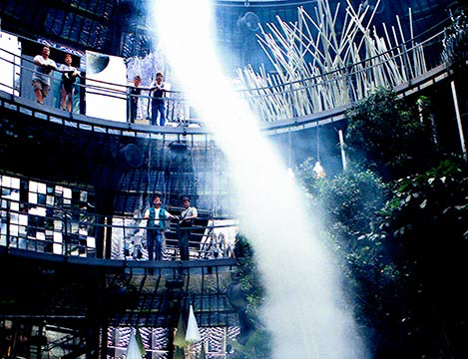
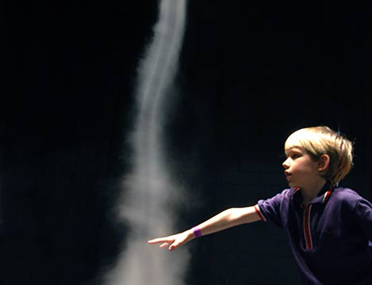
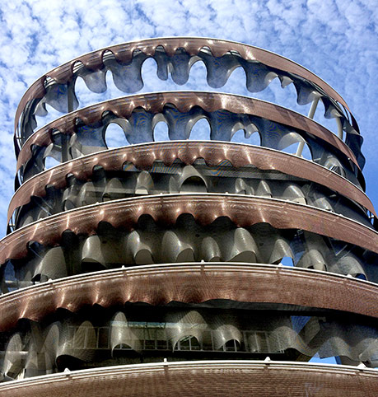
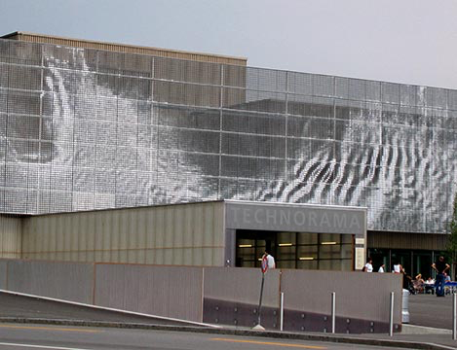
Ned Kahn (1960)
Radio Interview

Slide 20
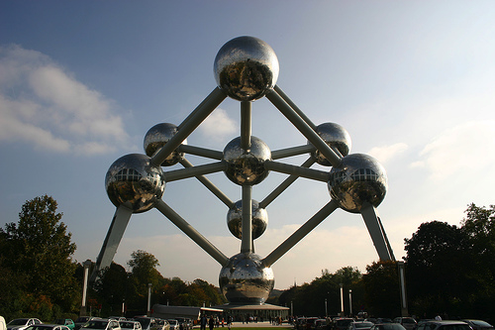
The Baudouin Experiment: A Large-Scale, Non-Fatalistic Experiment in Deviation, 2000, Carsten Höller (German b. 1961)
The Baudouin Experiment will take place in one of Belgium's most famous architectural landmarks: the Atomium. Built as the Belgian Pavilion for the 1958 World Fair in Brussels, the Atomium imitates the structure of an atom, and is made up of nine spheres connected by tubes. In the Brussels and European Conference Rooms, situated in the central sphere, a space will be set up to accommodate 100 people who are invited to spend twenty-four hours in the space, stepping out of their usual, "productive" lives for one day.
From 10.00am on 27 September until 10.00am on 28 September 2001, the space will be closed to the outside world. Public access will be denied, and the inhabitants will be allowed to cease their normal activities. They will do nothing at all, and they will do it collectively. The necessary infrastructure such as furniture, food, sanitary installations and safety measures will be provided. Though no particular programme or means of entertainment will be suggested, participants are free to bring with them what they wish. Essentially, the experiment will be to experience what happens when people are freed from their usual constraints and yet collectively confined to a particular space and time. The Baudouin/Boudewijn Experiment will not be documented by means of film or video; the only "recordings" will be the memories of the participants, and these will be disseminated through the stories they may tell after the event. The experiment will thus be completely unscientific, since objectivity is not the aim. Rather, it will be a unique opportunity to experience together the possibilities of escape from one’s daily routine, to participate in a unique event with an unclear outcome.

Slide 21
How can artists contribute to science?
AUDIENCE INVOLVEMENT
Audience members can also participate in research. Citizen Science is now valued in a variety of scientific and non-scientific contexts.

Slide 22
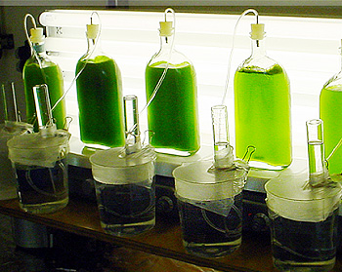
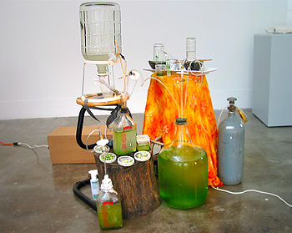
DIY Algae/Hydrogen Bioreactor Futurefarmers/Jonathan Meuser (2004)
Radio Interview

Slide 23
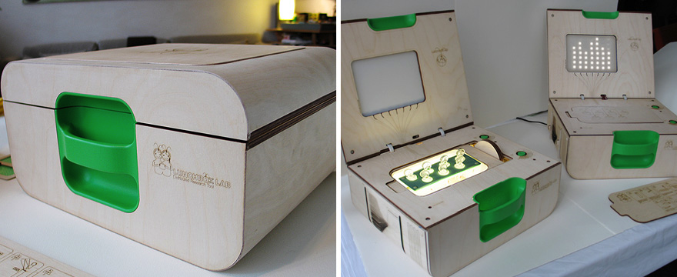
Lunchbox Laboratory Futurefarmers/Jonathan Meuser (at MOMA 2008)

Slide 24
How can artists contribute to science?
SUBJECTIVE CATEGORIZATIONS
Using and categorizing data and information in uninformed and “naive” ways allow unexpected connections and results to be made.

Slide 25
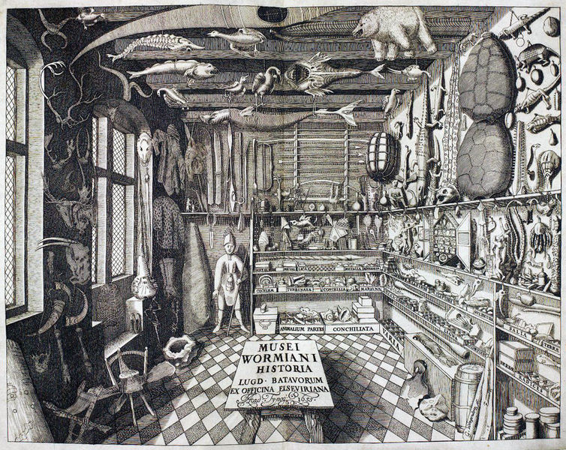
Olaus Wormius (1588-1654) Cabinet of Curiosity

Slide 26
Portia Munson, Pink Project: Table, 2016

Slide 27
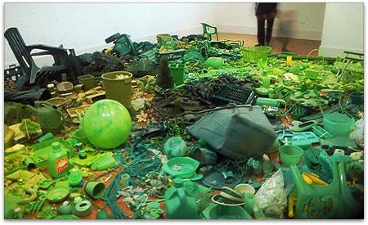
Portia Munson (1961), Green Piece, 2000

Slide 28
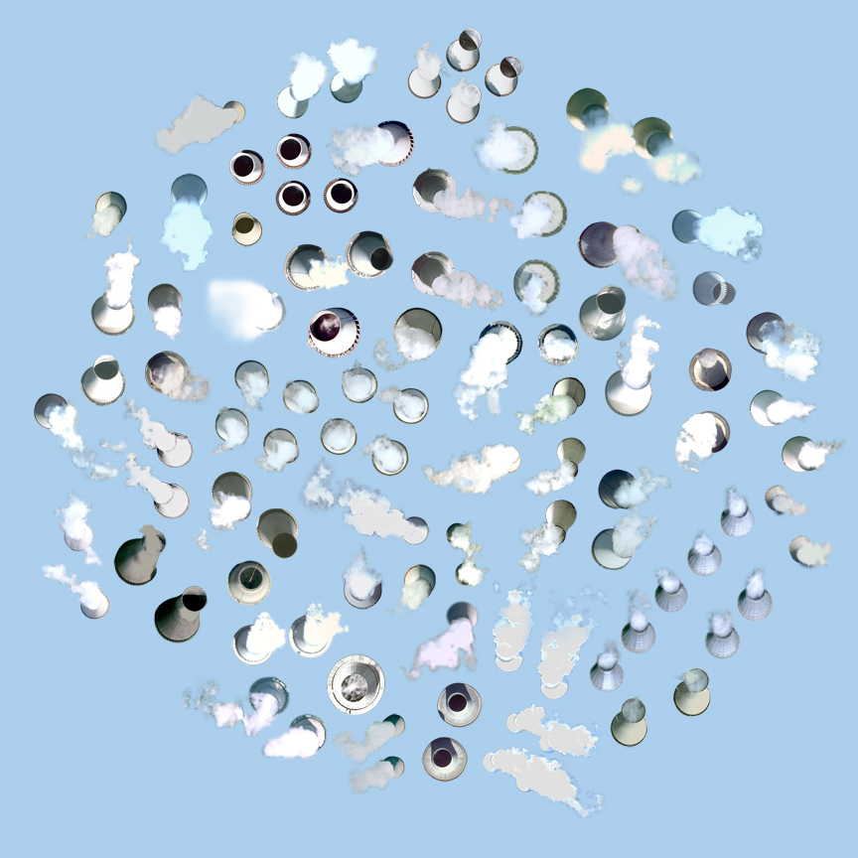
Satellite Collections - 97 Nuclear Cooling Towers, Jenny Odell (2009-2011) Website

Slide 29
Landfills and Swimming pools, Jenny Odell (2009-2011) Website

Slide 30
Karsten Bott, One of Each (1998). Found objects and wooden boardwalk

Slide 31
“Celestial Emporium of Benevolent Knowledge's Taxonomy” from Jorge Luis Borges (1899-1986), "The Analytical Language of John Wilkins” (1942)
Animals are divided into:
(a) belonging to the Emperor
(b) embalmed
(c) tame
(d) suckling pigs
(e) sirens
(f) fabulous
(g) stray dogs
(h) included in the present classification
(i) frenzied
(j) innumerable
(k) drawn with a very fine camel-hair brush
(1) et cetera
(m) having just broken the water pitcher
(n) that from a long way off look like flies

Slide 32
#

