Slide 1
Period 2
Investigations – Science/World

Slide 2
Lecture Interaction
on your mobile go to
www.sli.do
Code for the lecture today: inv2

Slide 3
Four Strands of Sci-Art
Art as a communicator of science, where the artist represents the science to the outside world.
Science as a means of production, where scientific methods, experimentation and technologies become the channel through which art is processed and made.
Science as art – for example, when a snapshot of a cell is admired as beautiful.
A fluid interchange between science and art where their different methods and processes are allowed to co-exist and thrive.
Ariane Koek (Director of CERN’s Artist in Residence Program)

Slide 4
How can artists contribute to science?
EXPLORING SOCIAL IMPLICATIONS
Art can help create an understanding of the implications of scientific research on society and people.

Slide 5
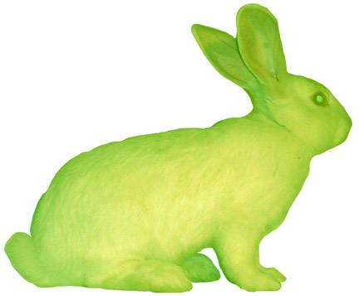
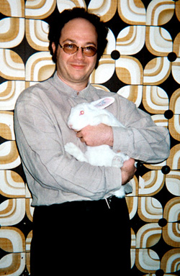
GFP Bunny (2000), Eduardo Kac (American, b.1962)

Slide 6
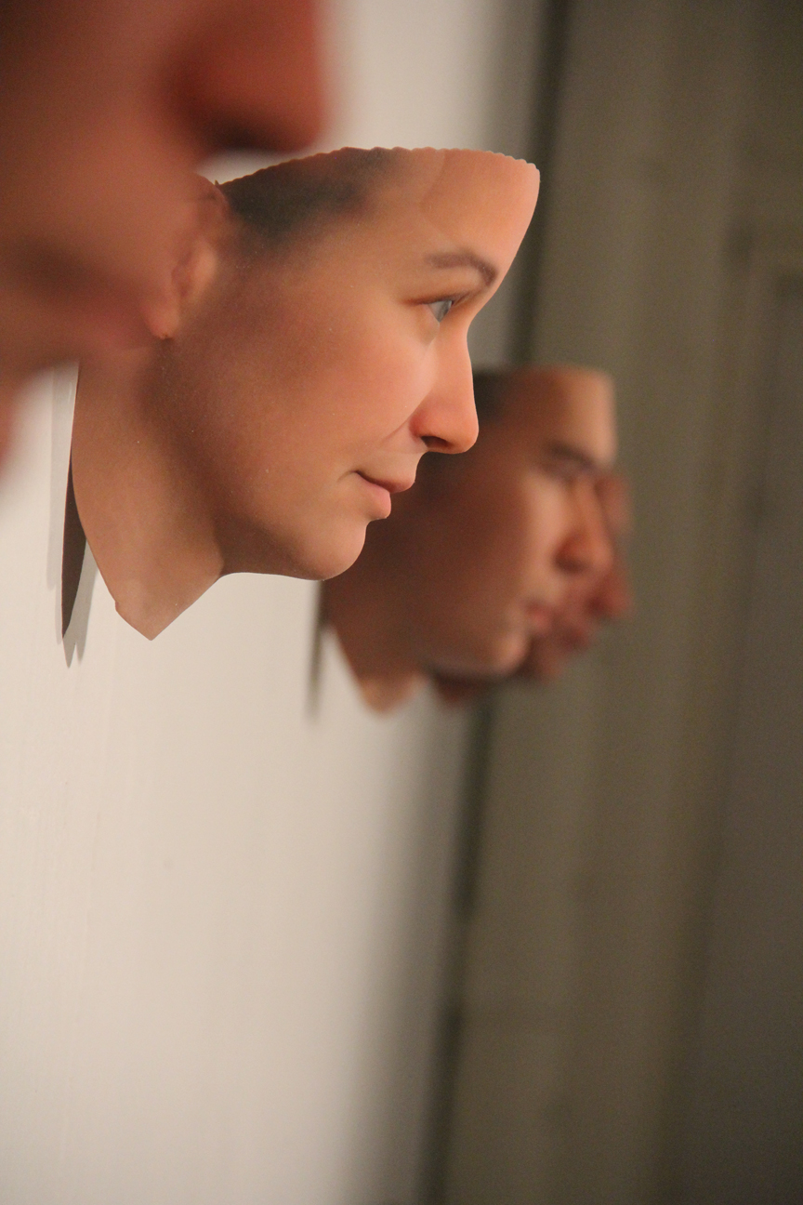
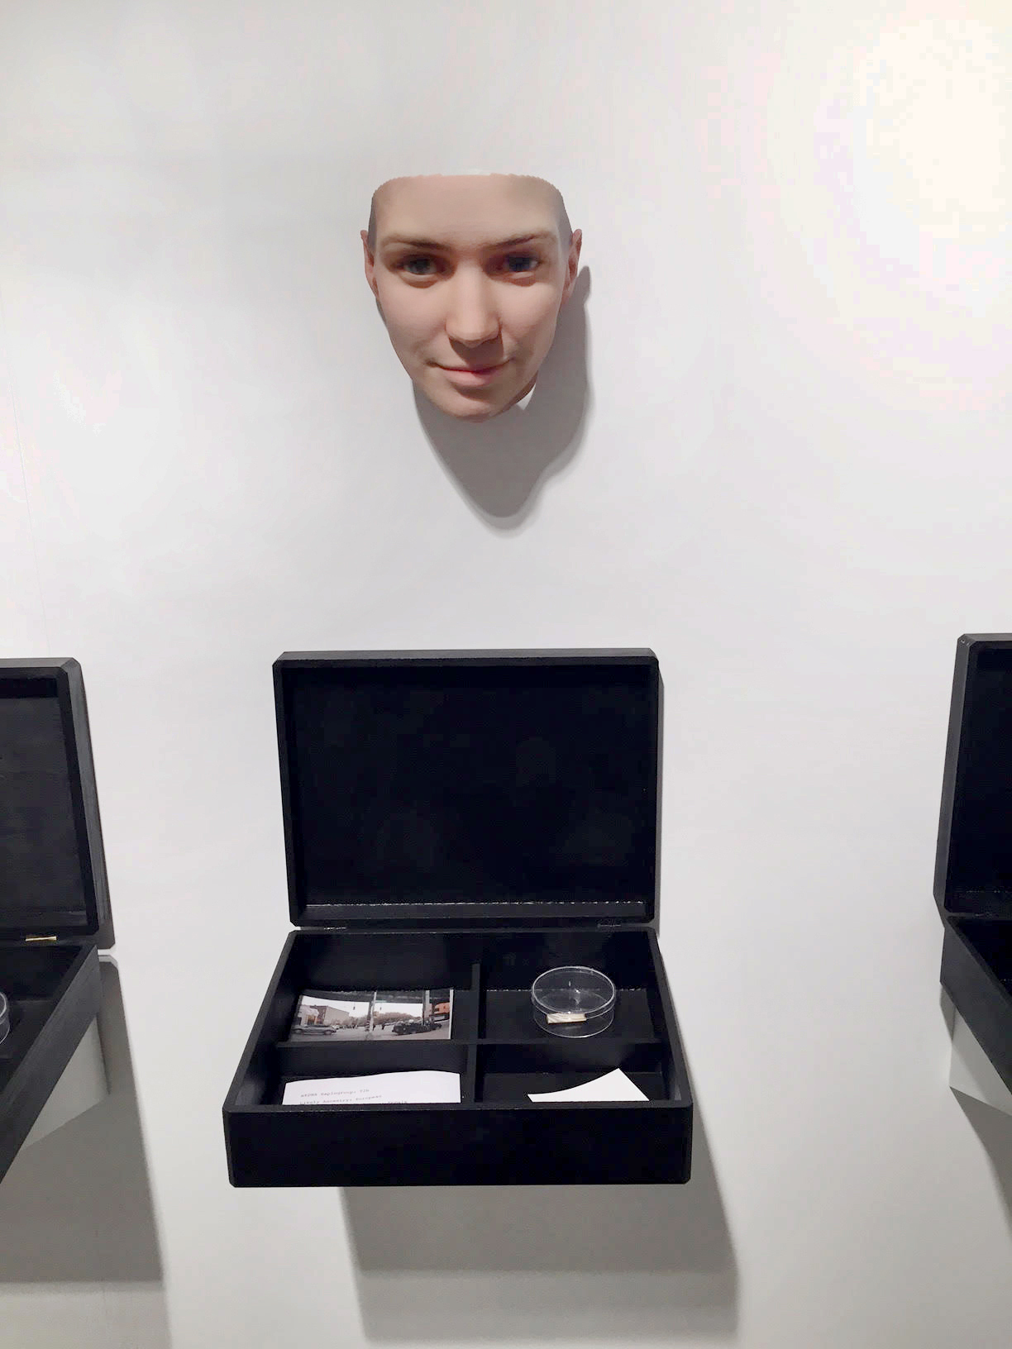
Stranger Visions (2012-2013), Heather Dewey- Hagborg (1982) video

Slide 7
Heather Dewey- Hagborg
“Due to its liminal status, art at the intersection of science is uniquely poised as a critical practice. Its form manifests as a kind of ‘double gesture’, the ‘necessary and the impossible’ collide in a type of self-reflexive art that examines its own terms. This doubling is both a critique and homage. By dissecting its very materials, this conceptually driven form utilizes a medium to reflect upon itself. It is an understanding that perhaps we can only come to know something by engaging it very deeply. We can only criticize that which we have lived. Such a double form comes from a place of passion for the beauty and elegance of science, of genuine love for the act of experimentation, combined with an endeavor to realize its framing, an attempt to understand its flaws, limitations, and biases.”

Slide 8
How can artists contribute to science?
MAKING THE INVISIBLE VISIBLE
Artists are highly trained in metaphors and scientists are dependent on metaphors to create understandings of what they are doing.

Slide 9
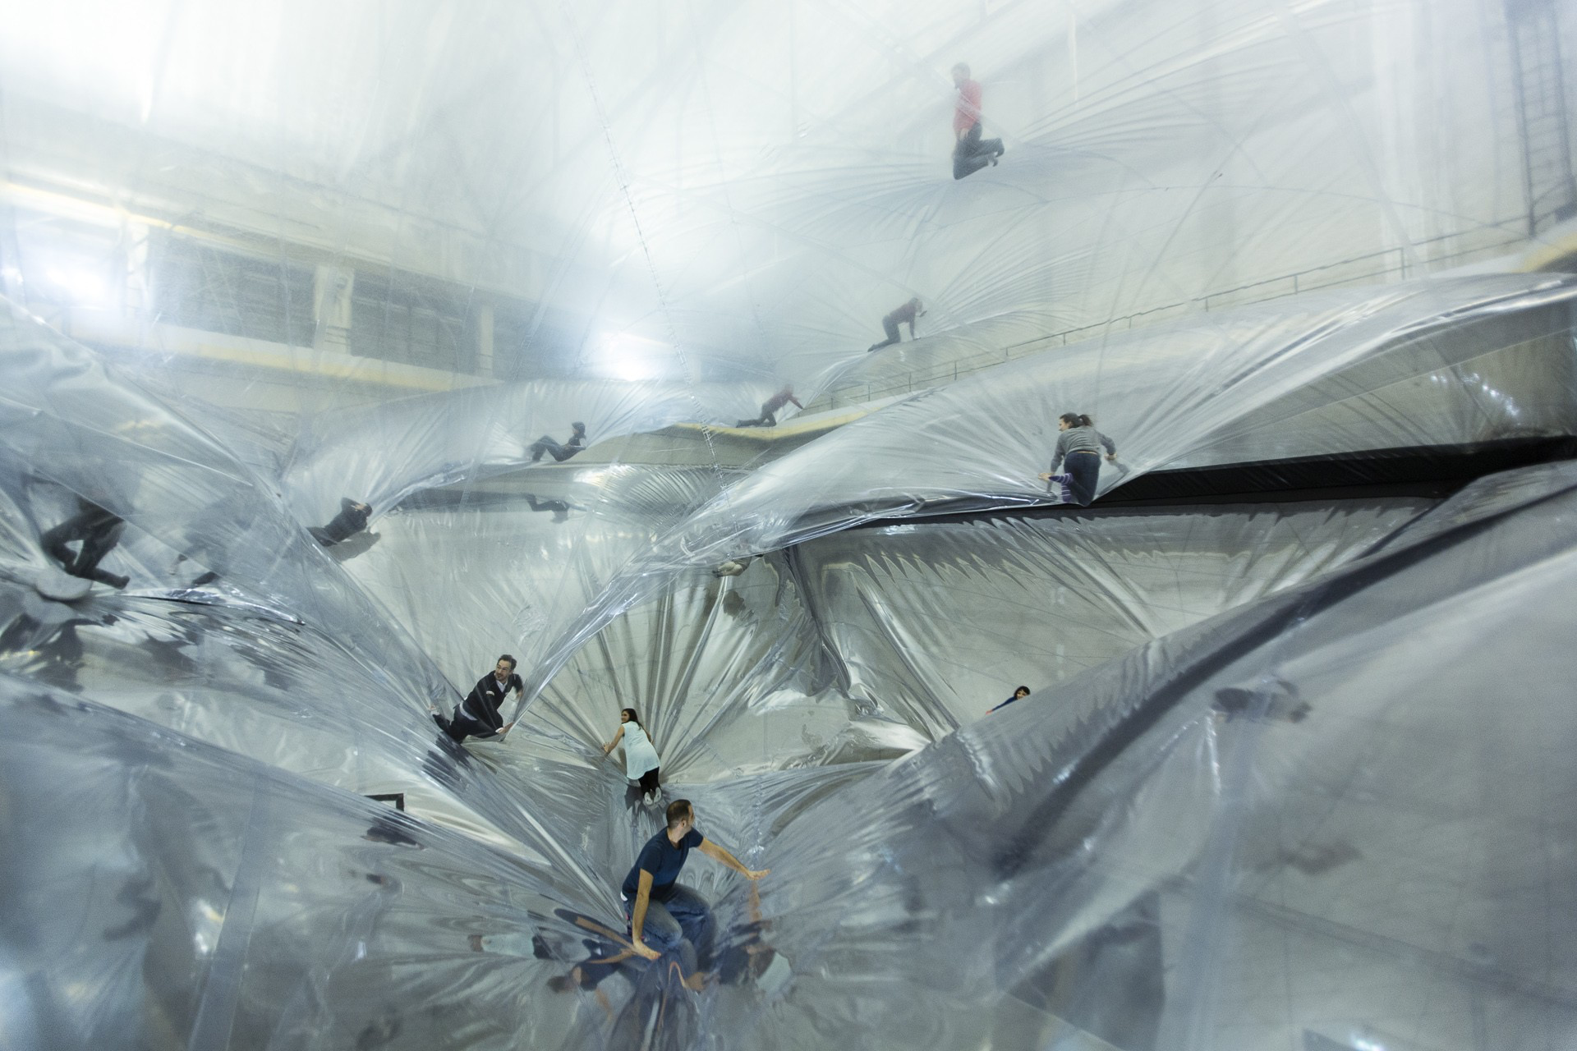
On Space Time Foam (2013), Tomás Saraceno (b. 1973)

Slide 10
On Space Time Foam (2013), Tomás Saraceno (Argentinian, b. 1973)

Slide 11
How can artists contribute to science?
Art can have a point of view - an “agenda”. It can explicitly strive to initiate change.

Slide 12
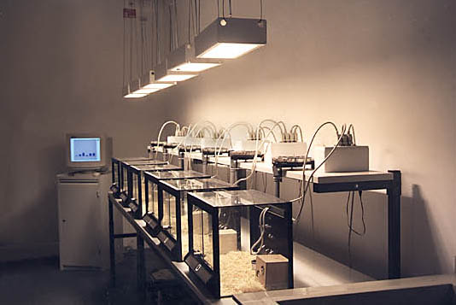
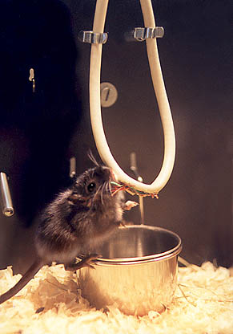
Byte (1998), Christopher Ebener & Uli Winters

Slide 13
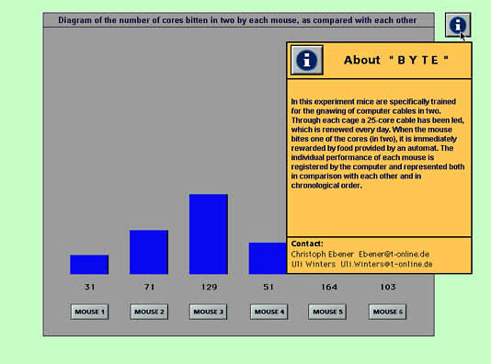
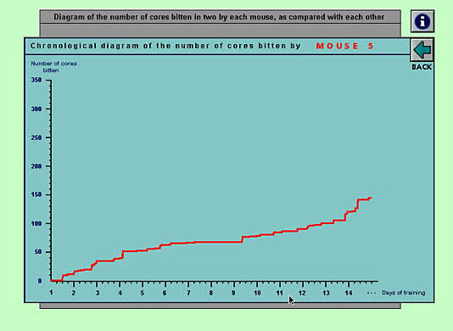
Byte (1998), Christopher Ebener
& Uli Winters

Slide 14
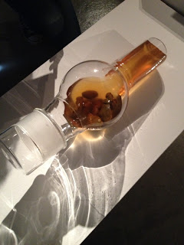
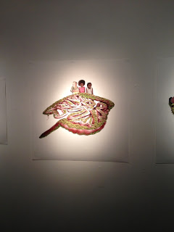
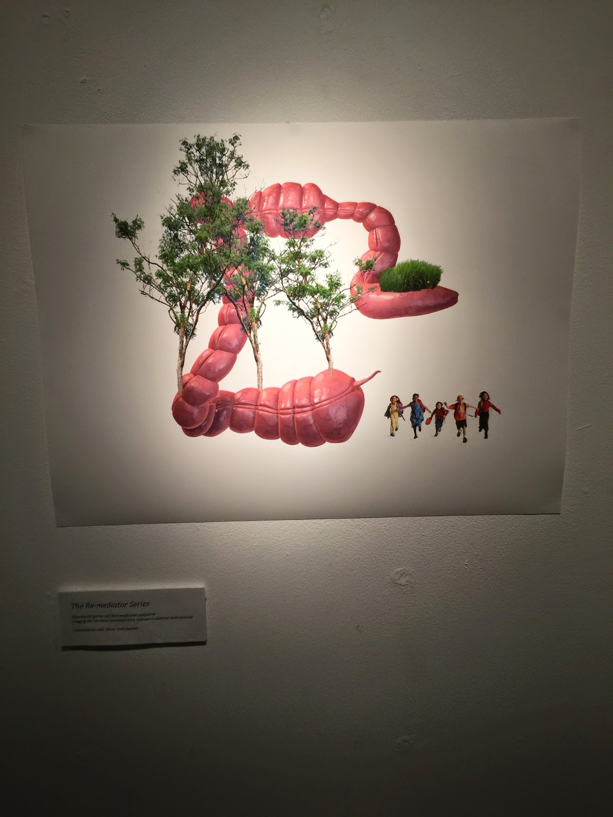
Fecal Matters: You Are My Future (2015), Kathy High (1954)

Slide 15
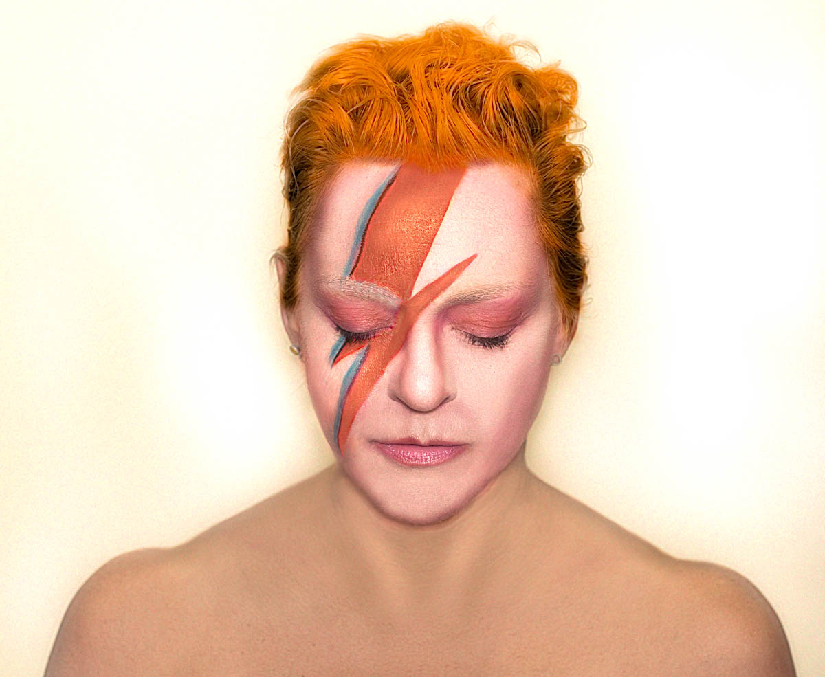

Slide 16
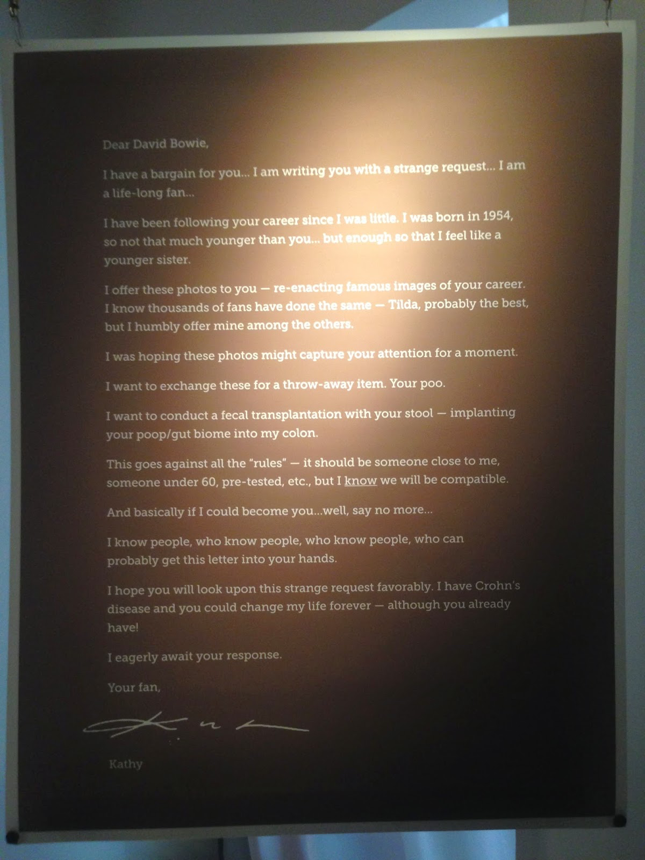

Slide 17
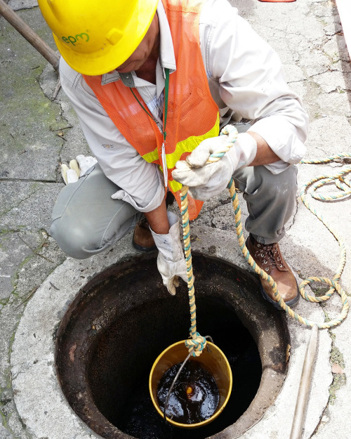
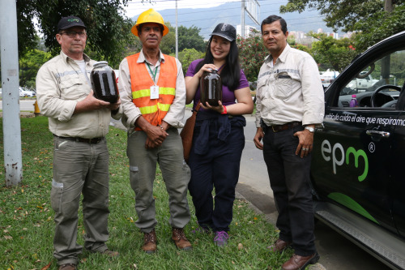
The Sewer Soaperie (2016), Catherine Sarah Young (1983)

Slide 18
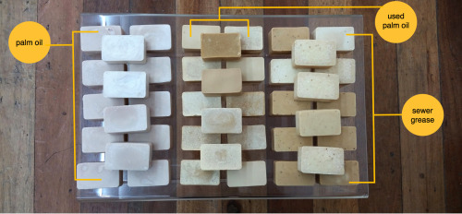
The Sewer Soaperie (2016), Catherine Sarah Young (1983)

Slide 19
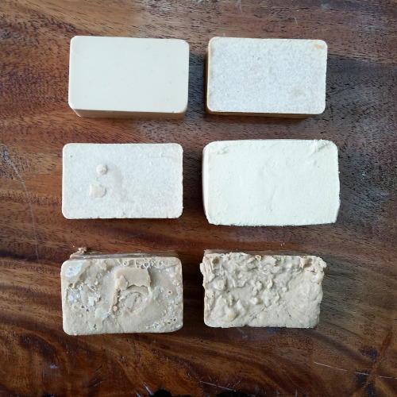
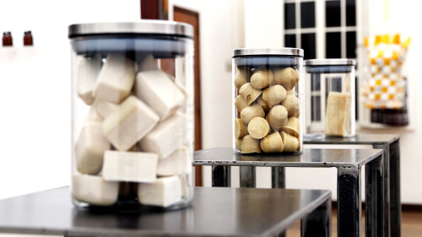
The Sewer Soaperie (2016), Catherine Sarah Young (1983)

Slide 20
How can artists contribute to science?
ARTISTS CAN EXPLORE UNORTHODOX LINES OF INQUIRY
Artworks are evaluated using different criteria than scientific projects, (aesthetic, poetic …) and because of that the work might help us find things that are not discovered through “normal science”.

Slide 21
Dawn Chorus, 2007, Marcus Coates

Slide 22
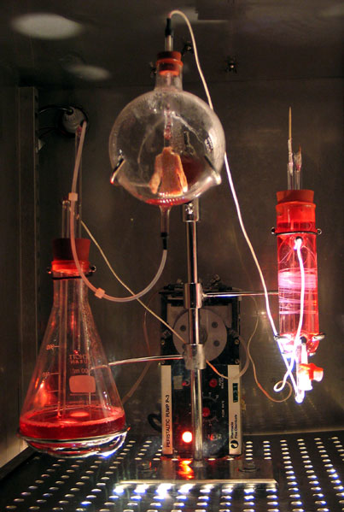
by Symbiotica
Victimless Leather (2004)
Video 1
Video 2
Video 3

Slide 23
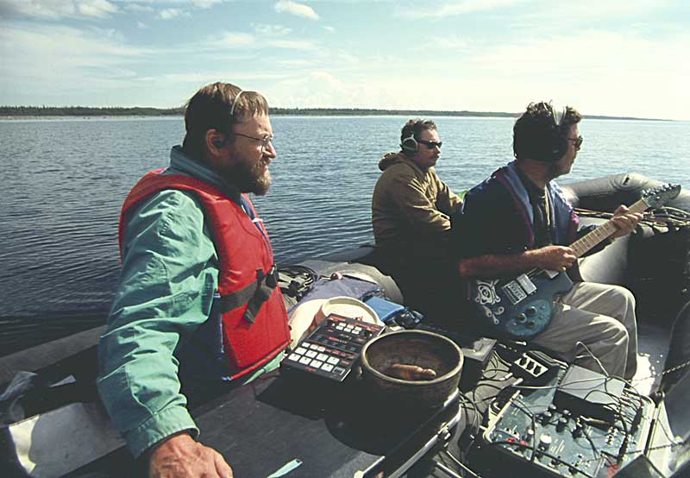
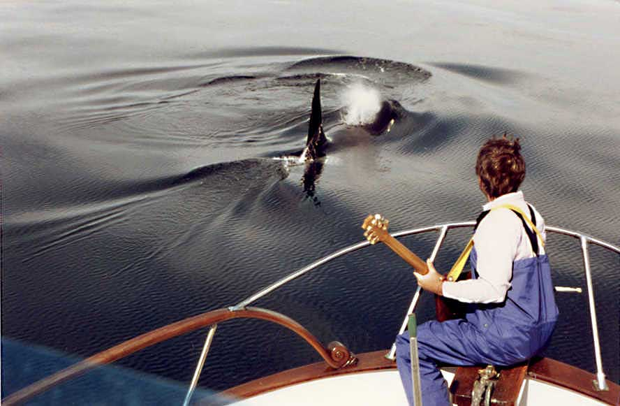
Orca Reggae Jim Nollman and Orcas (1983)

